Slide 1
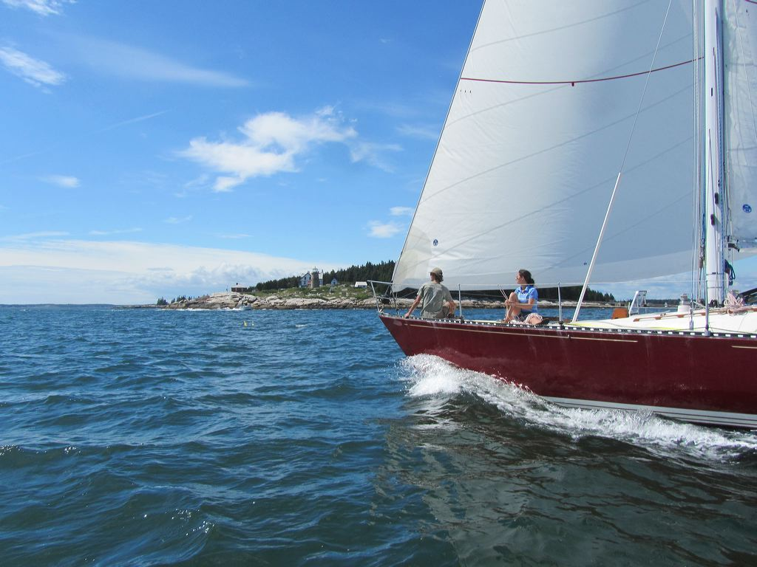
MIT Offshore Sailing Shore School IAP 2016
Session 1

Slide 2
Agenda
Introduction
Tales of adventure
Types of boats
Boat layout
Boat systems
Life aboard
Safety Basics

Slide 3
Course Schedule: IAP 2016
Date | Topic
Tue Jan 5th | Introduction to Keelboats
Thurs Jan 7th | Navigation #1
Tue Jan 12th | Navigation #2
Thurs Jan 14th | Racing
Tue Jan 19th | Safety at Sea
Thurs Jan 21st | Chartering a Boat
Tue Jan 26th | Weather
Thurs Jan 28th | Celestial Navigation

Slide 4
Why We’re Here
Charter a cruise in the Virgin Islands
Sail with friends in Boston Harbor
Join a local sailing club
Buy yourself your own sailboat
Sail across the Atlantic
This is not a substitute for a certified training course like ASA 101

Slide 5
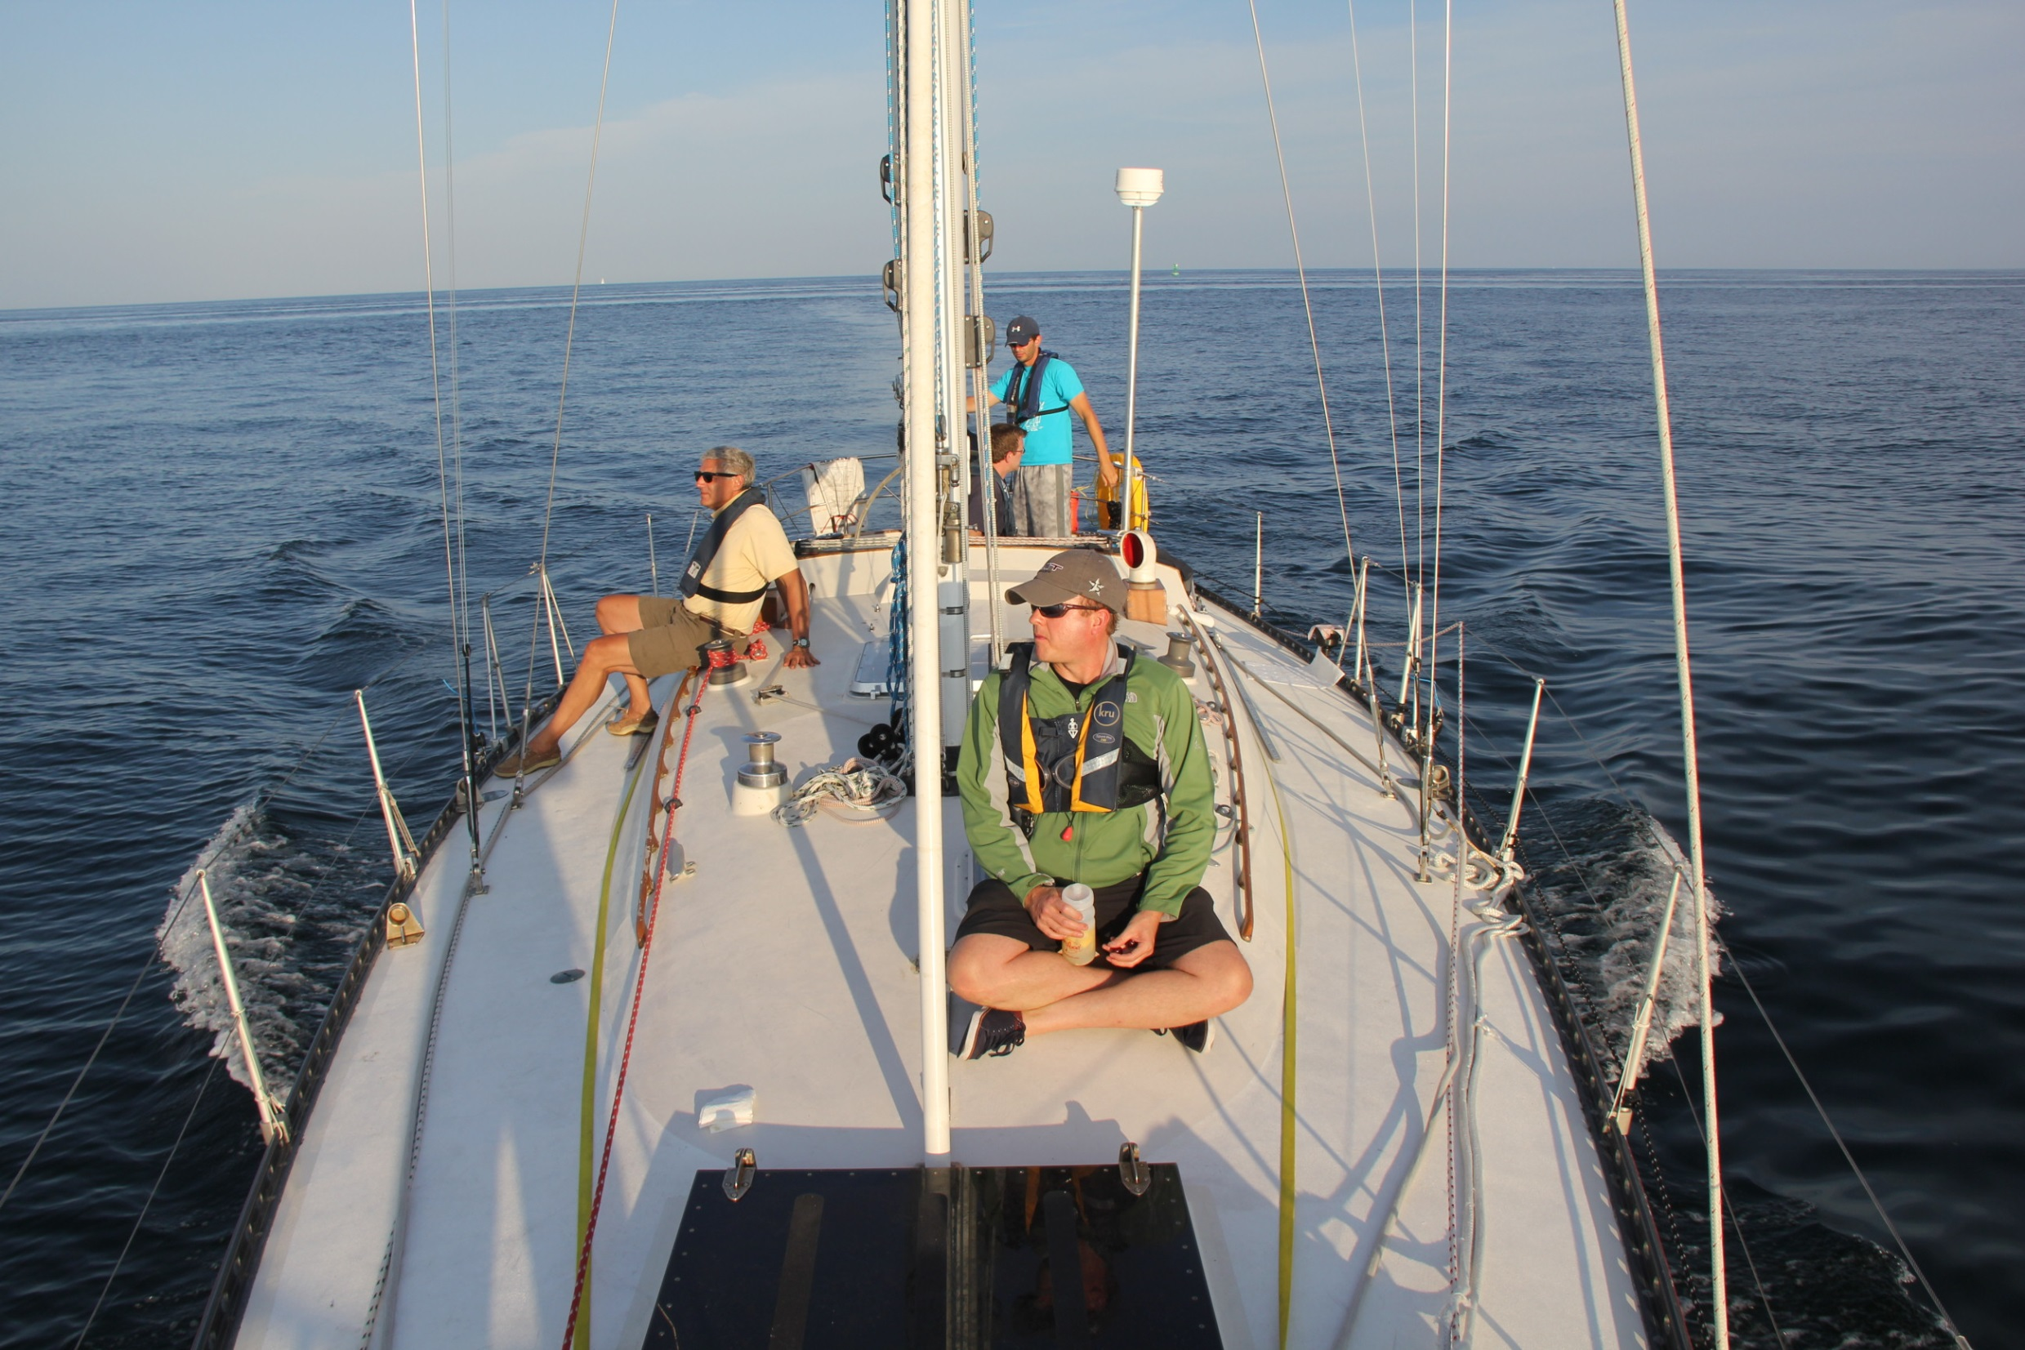

Slide 6
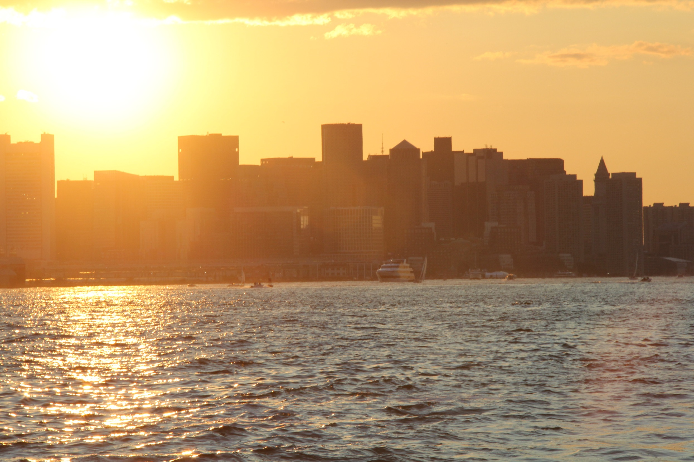

Slide 7
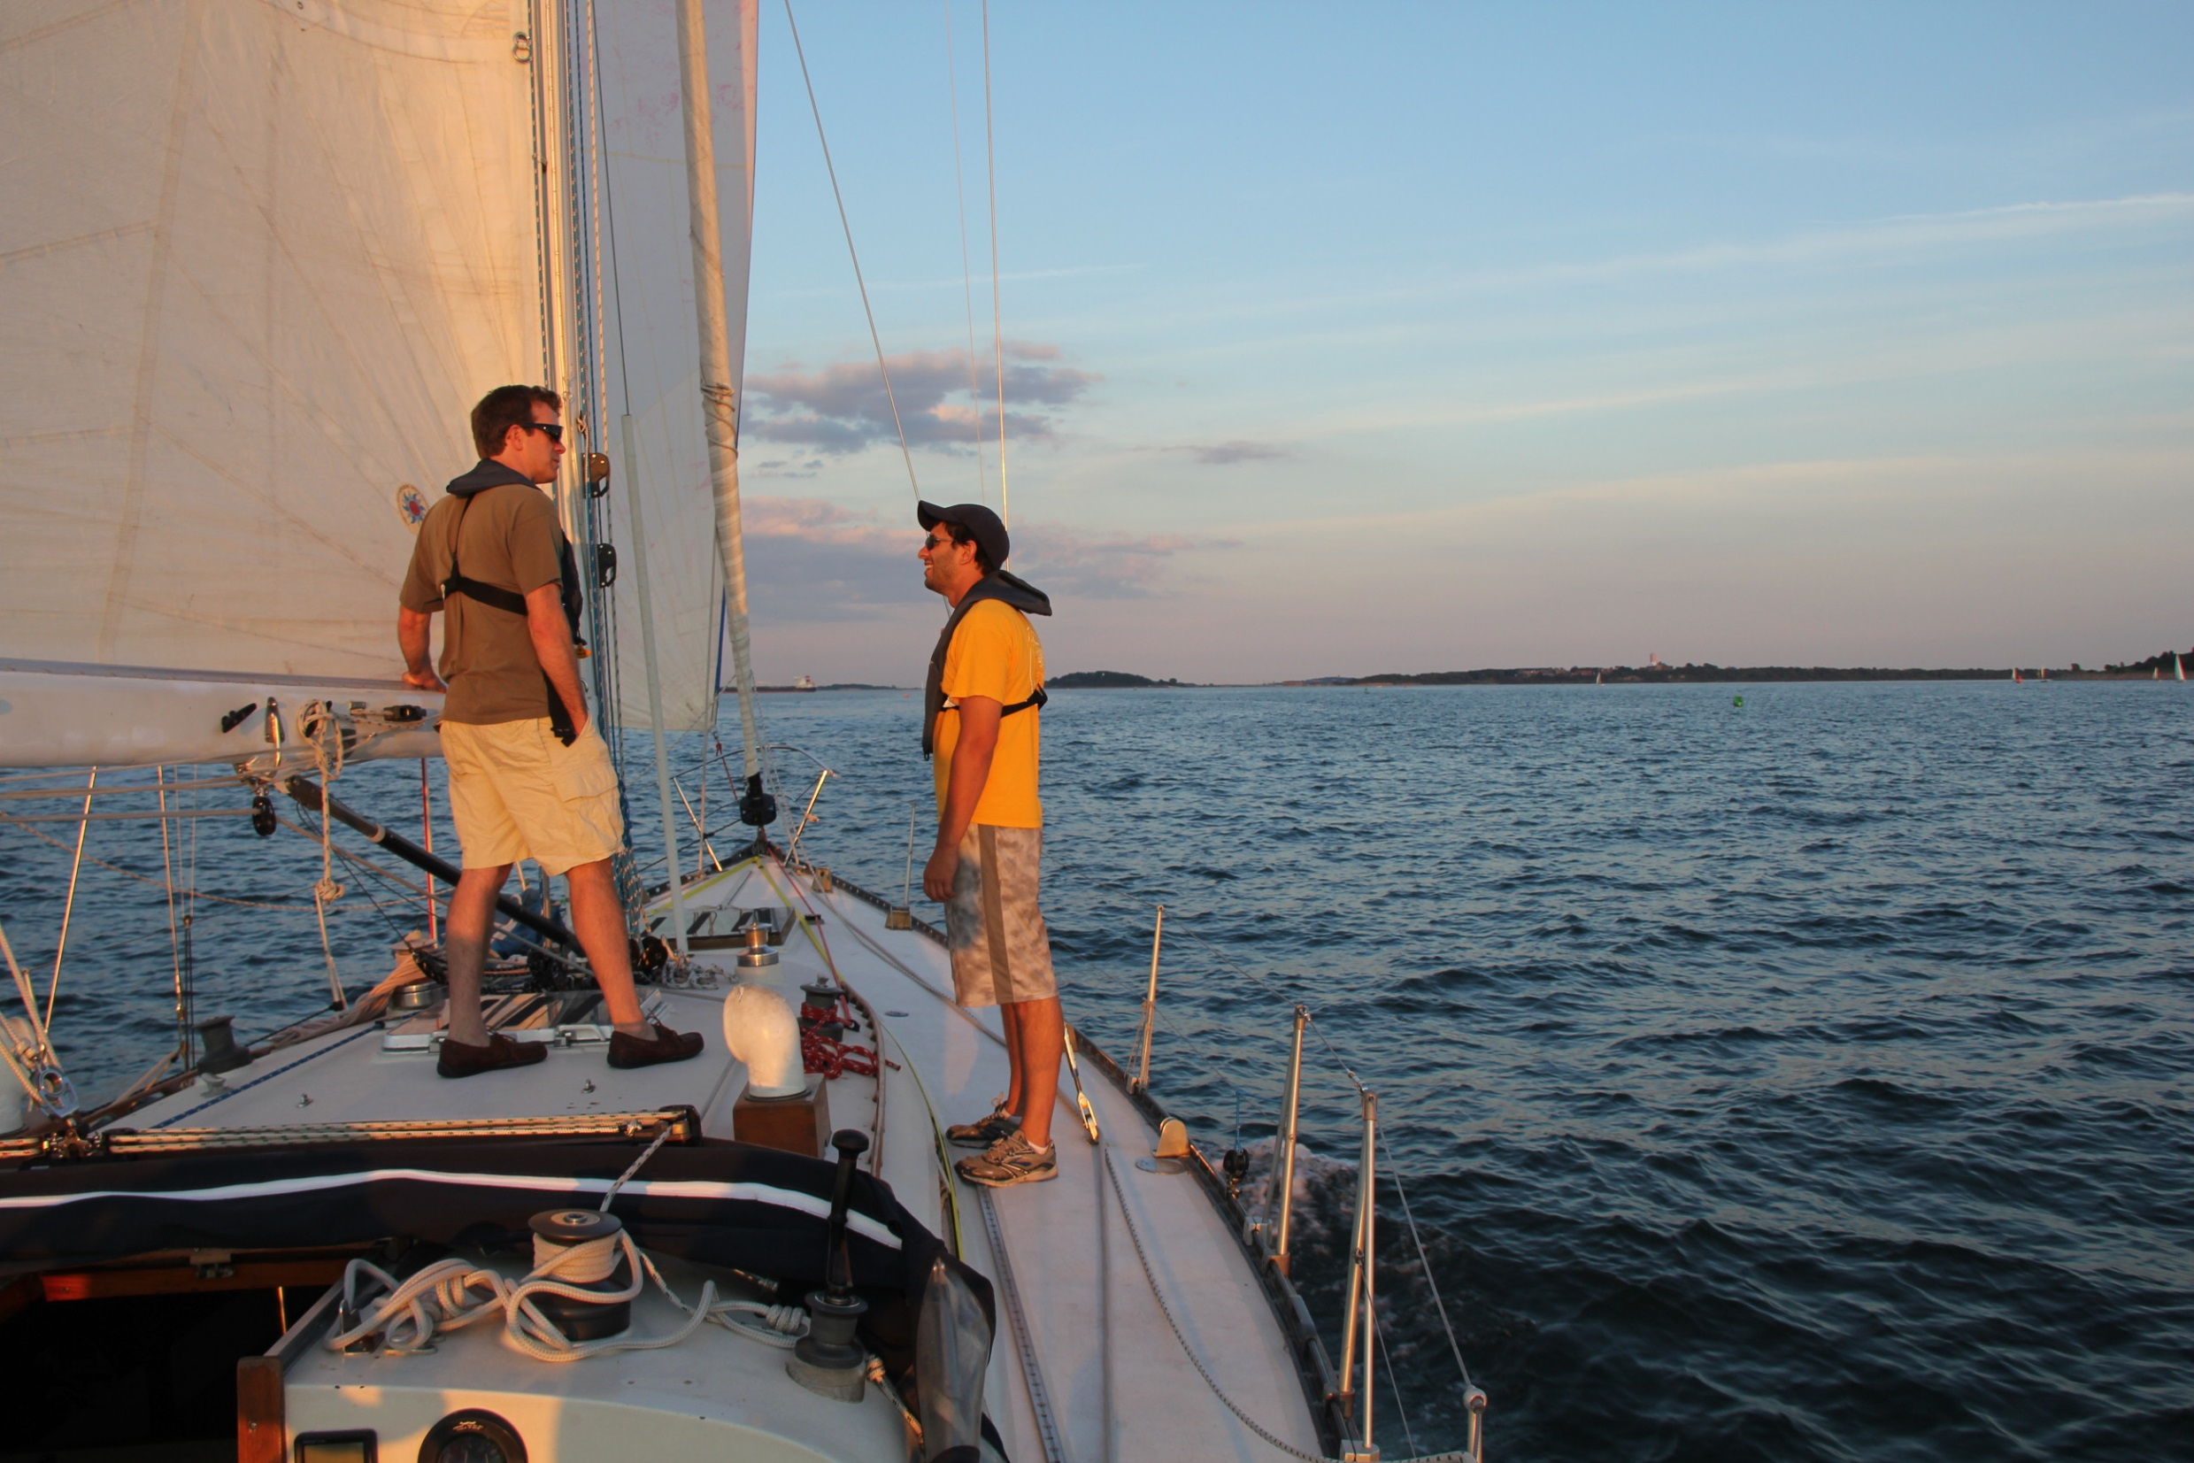

Slide 8
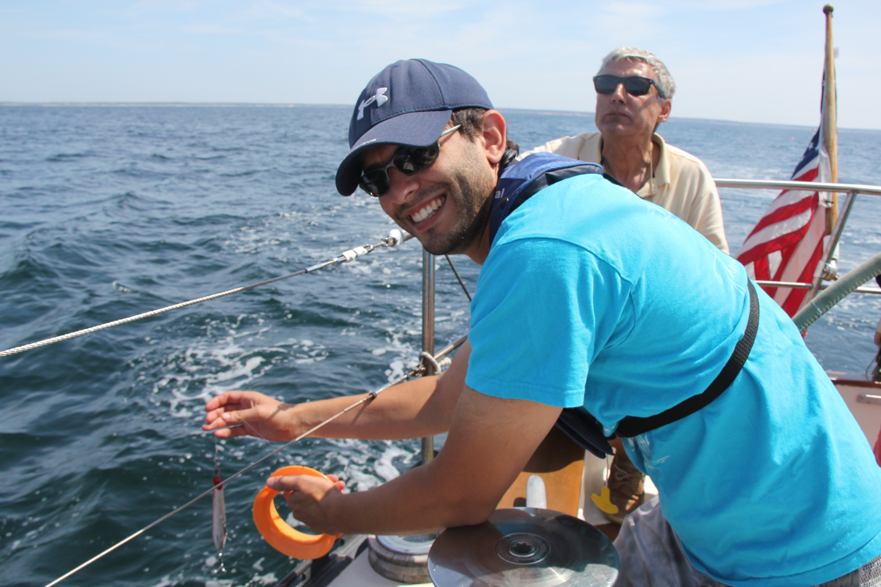

Slide 9
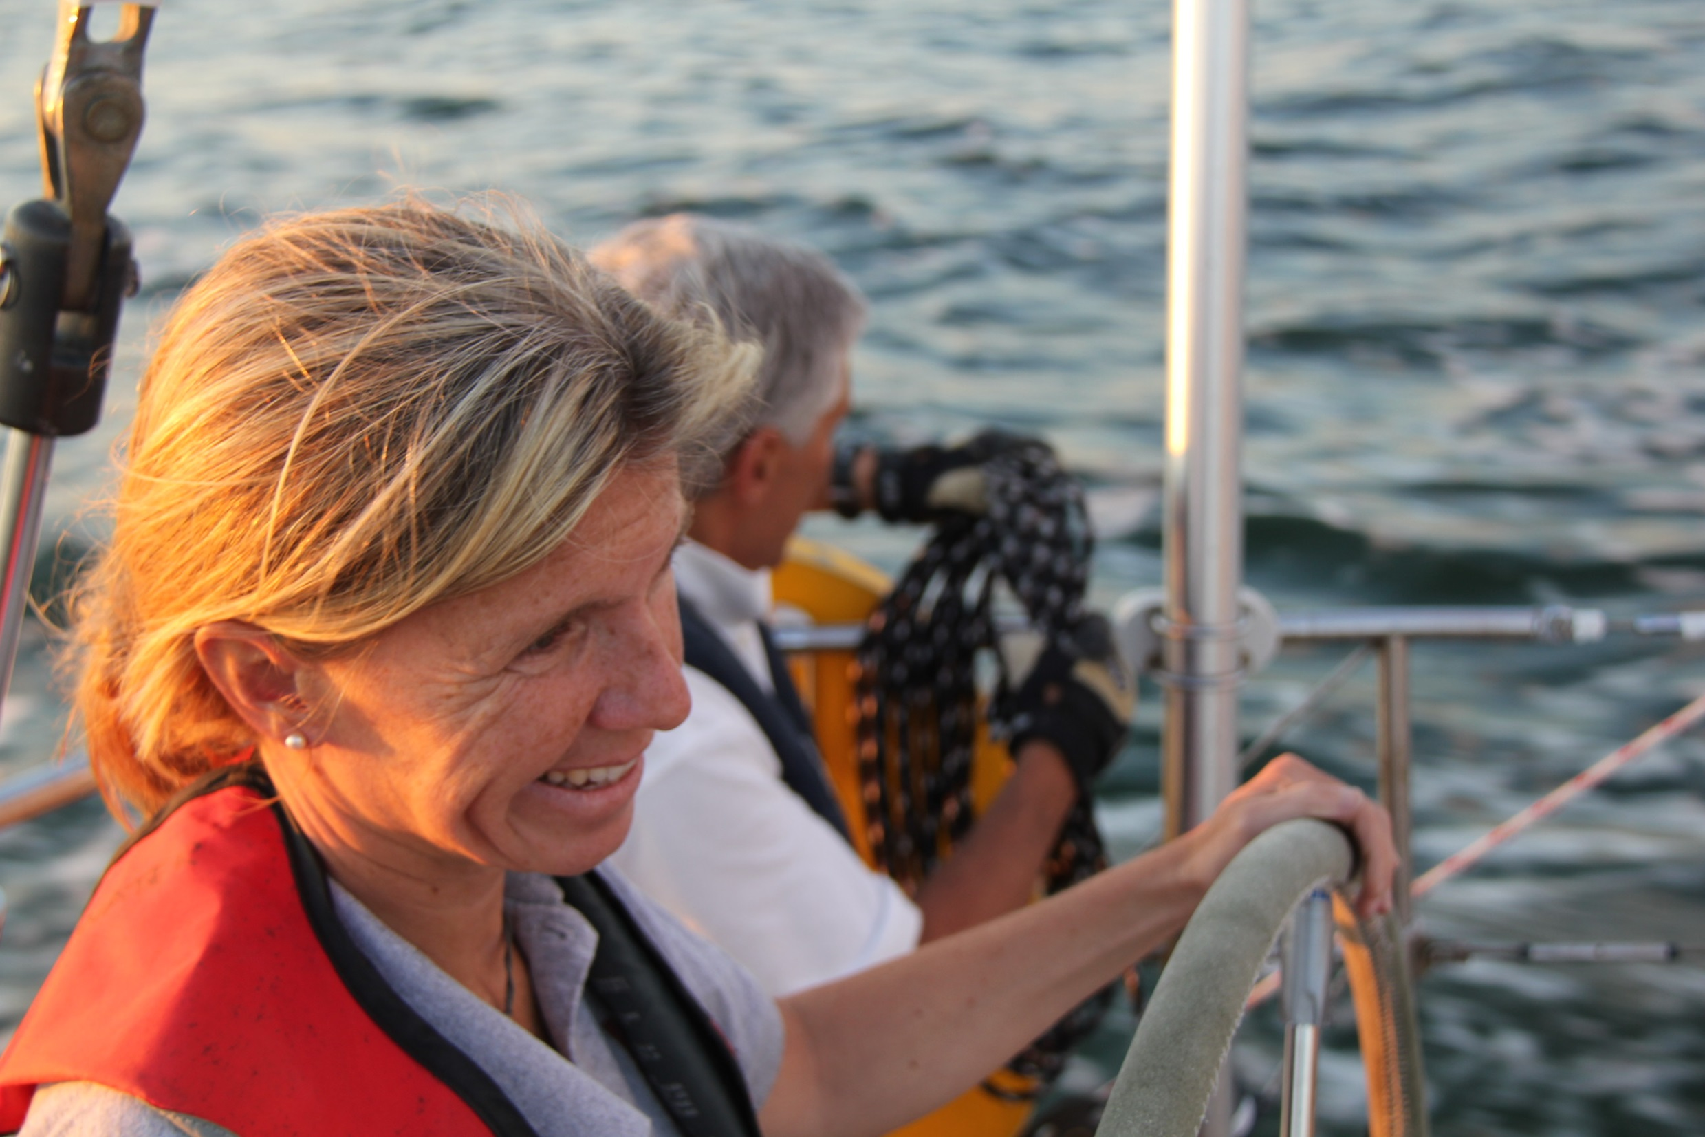

Slide 10
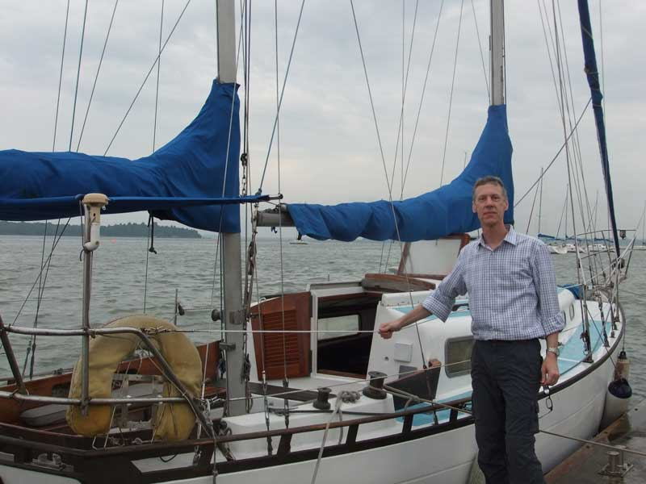

Slide 11
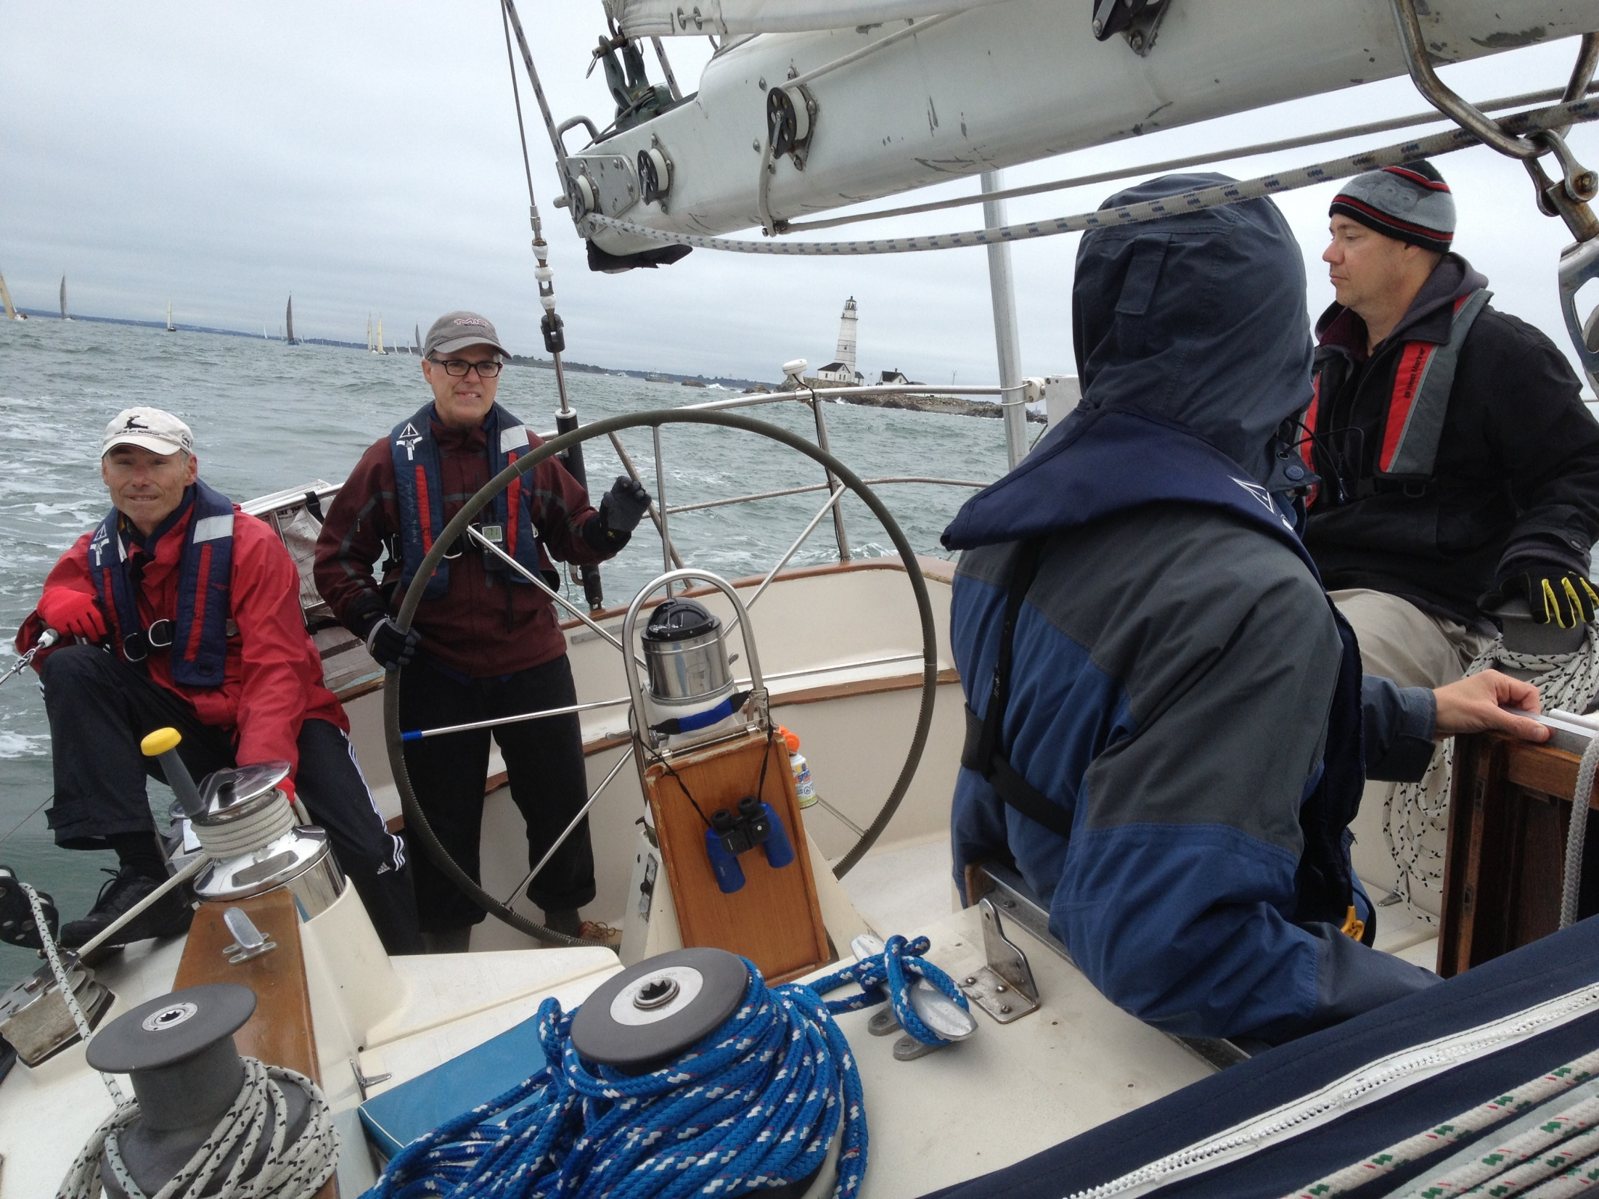

Slide 12
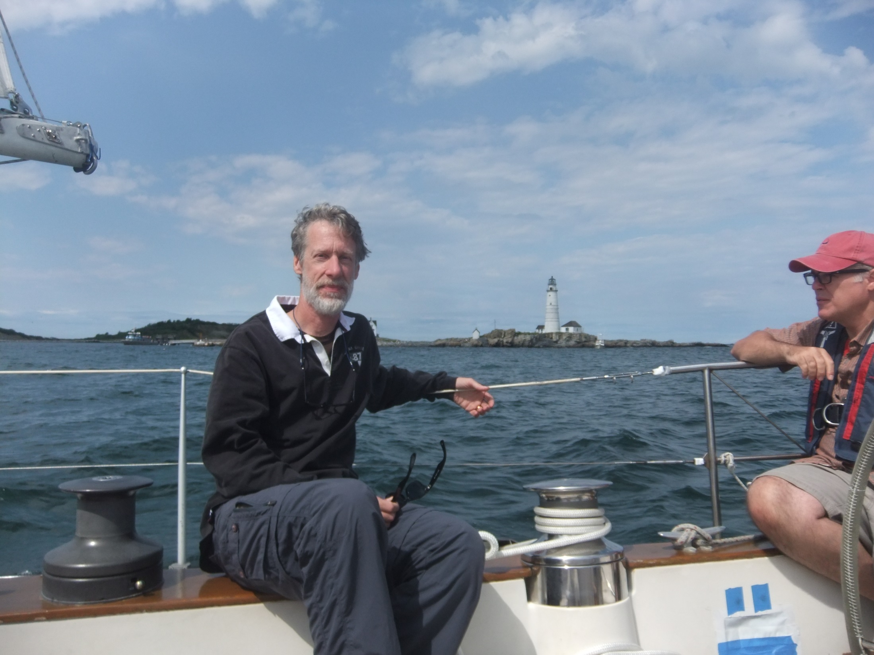

Slide 13
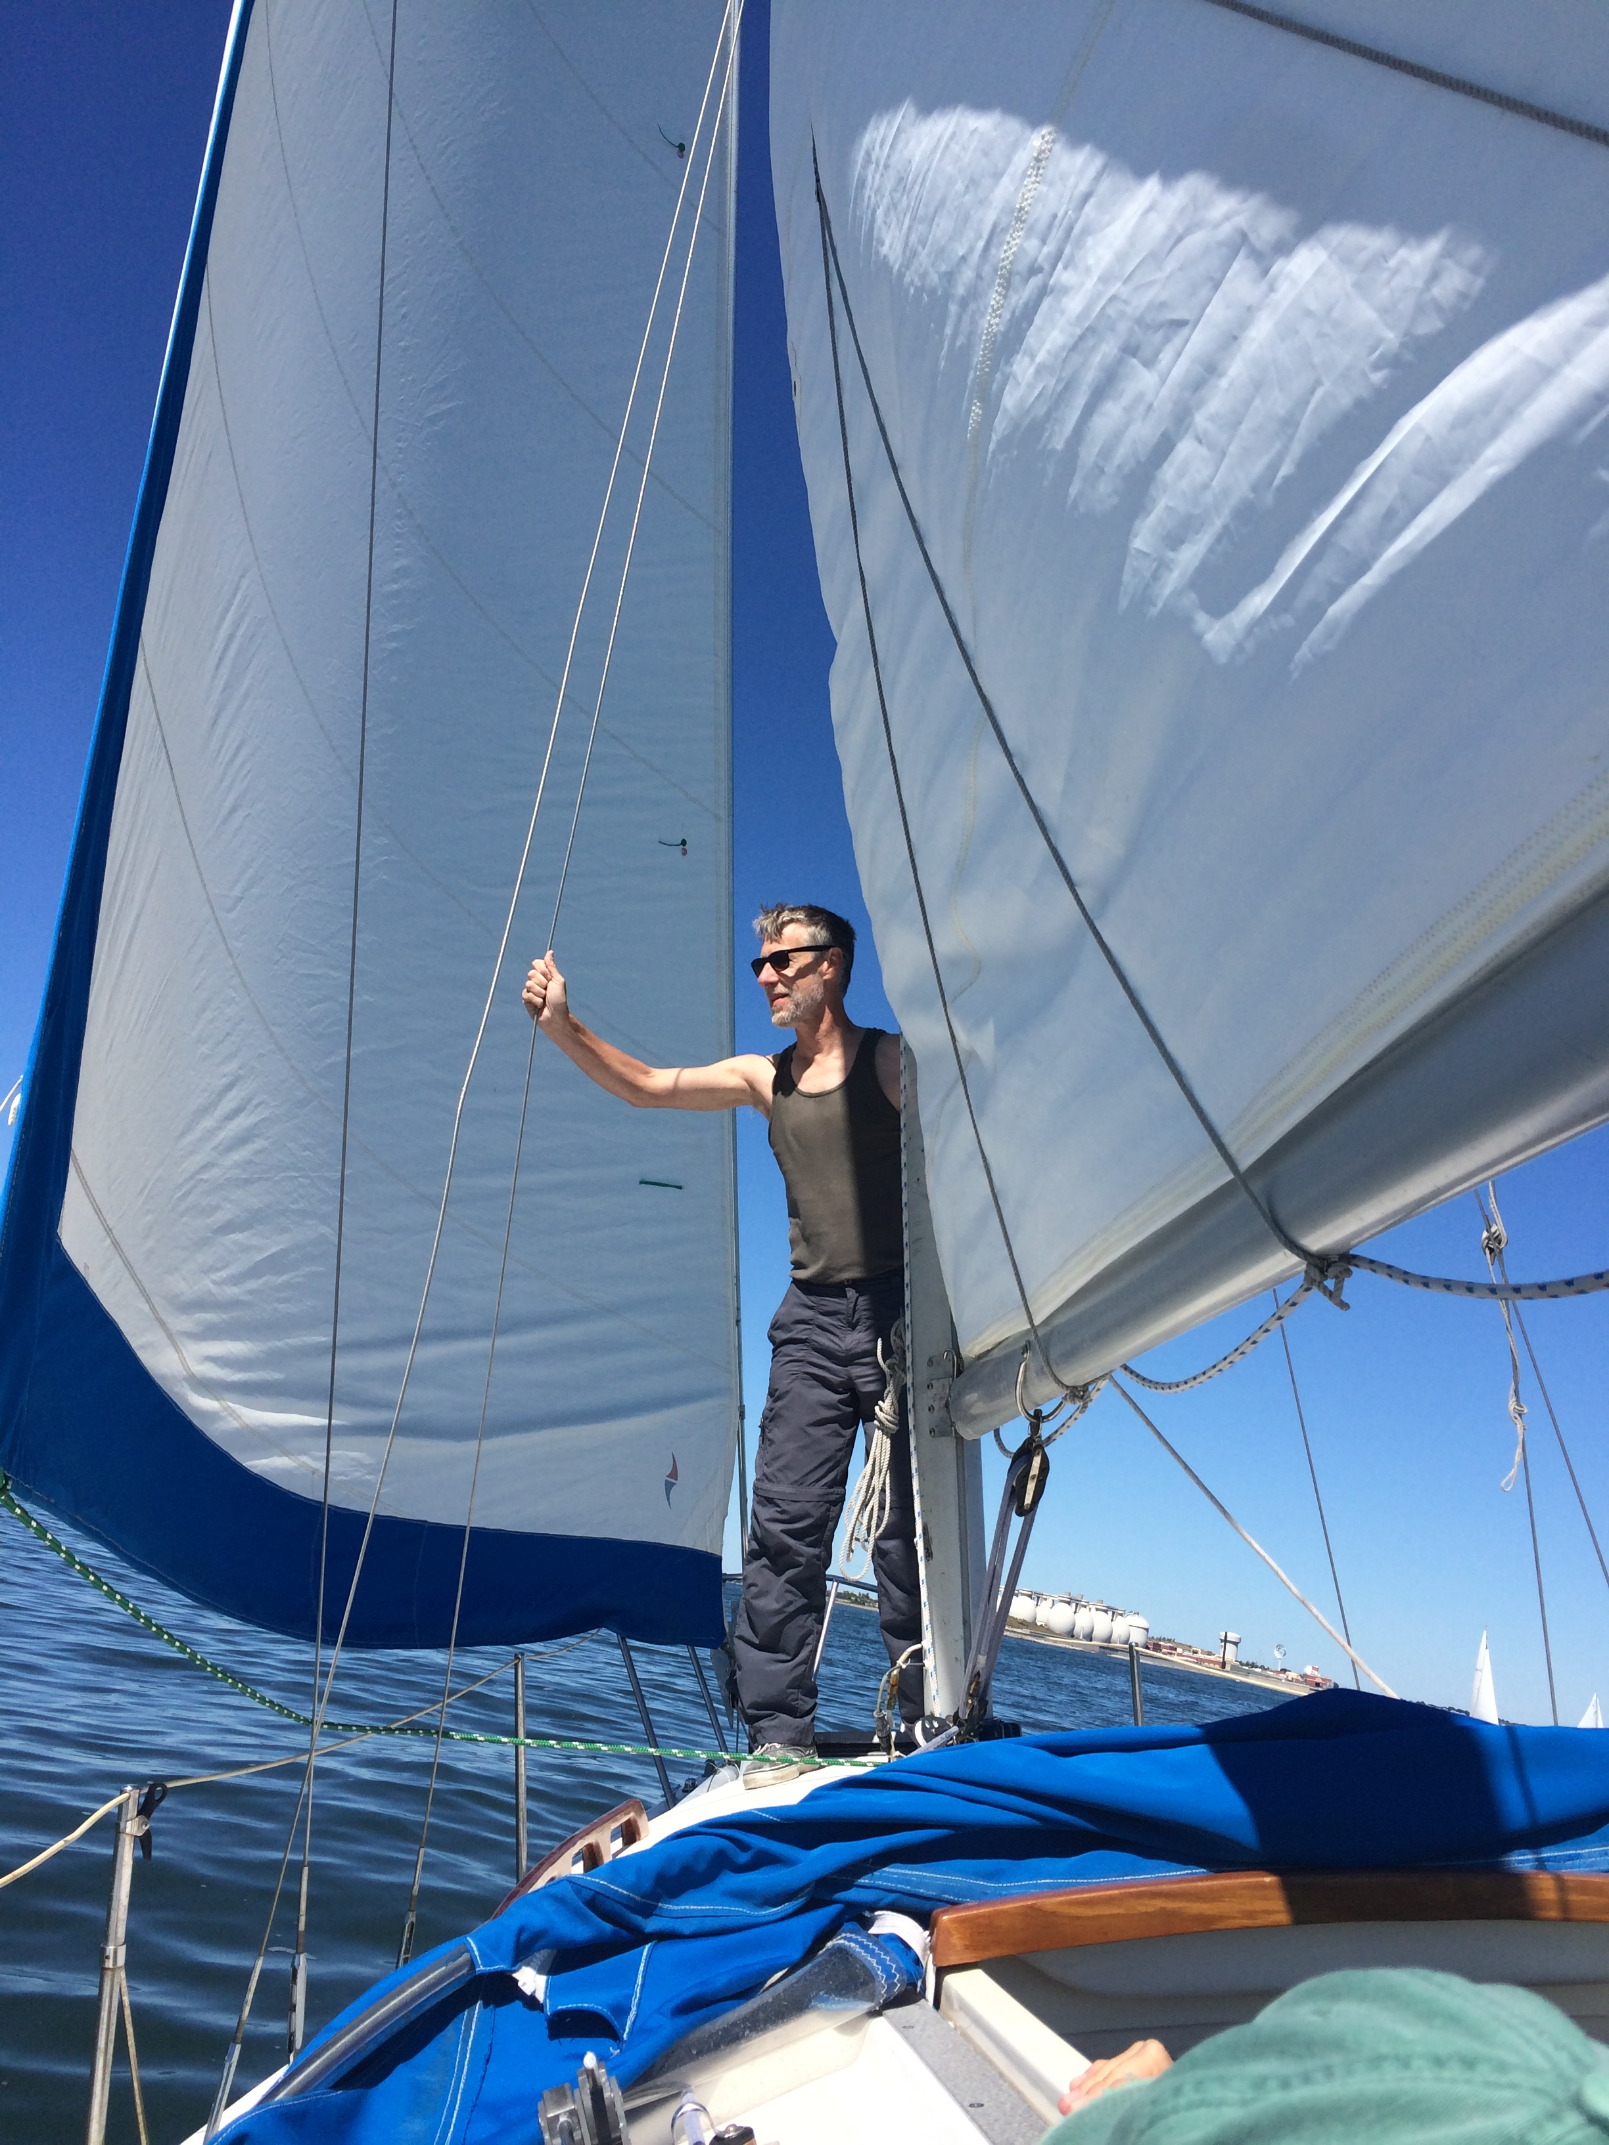

Slide 14
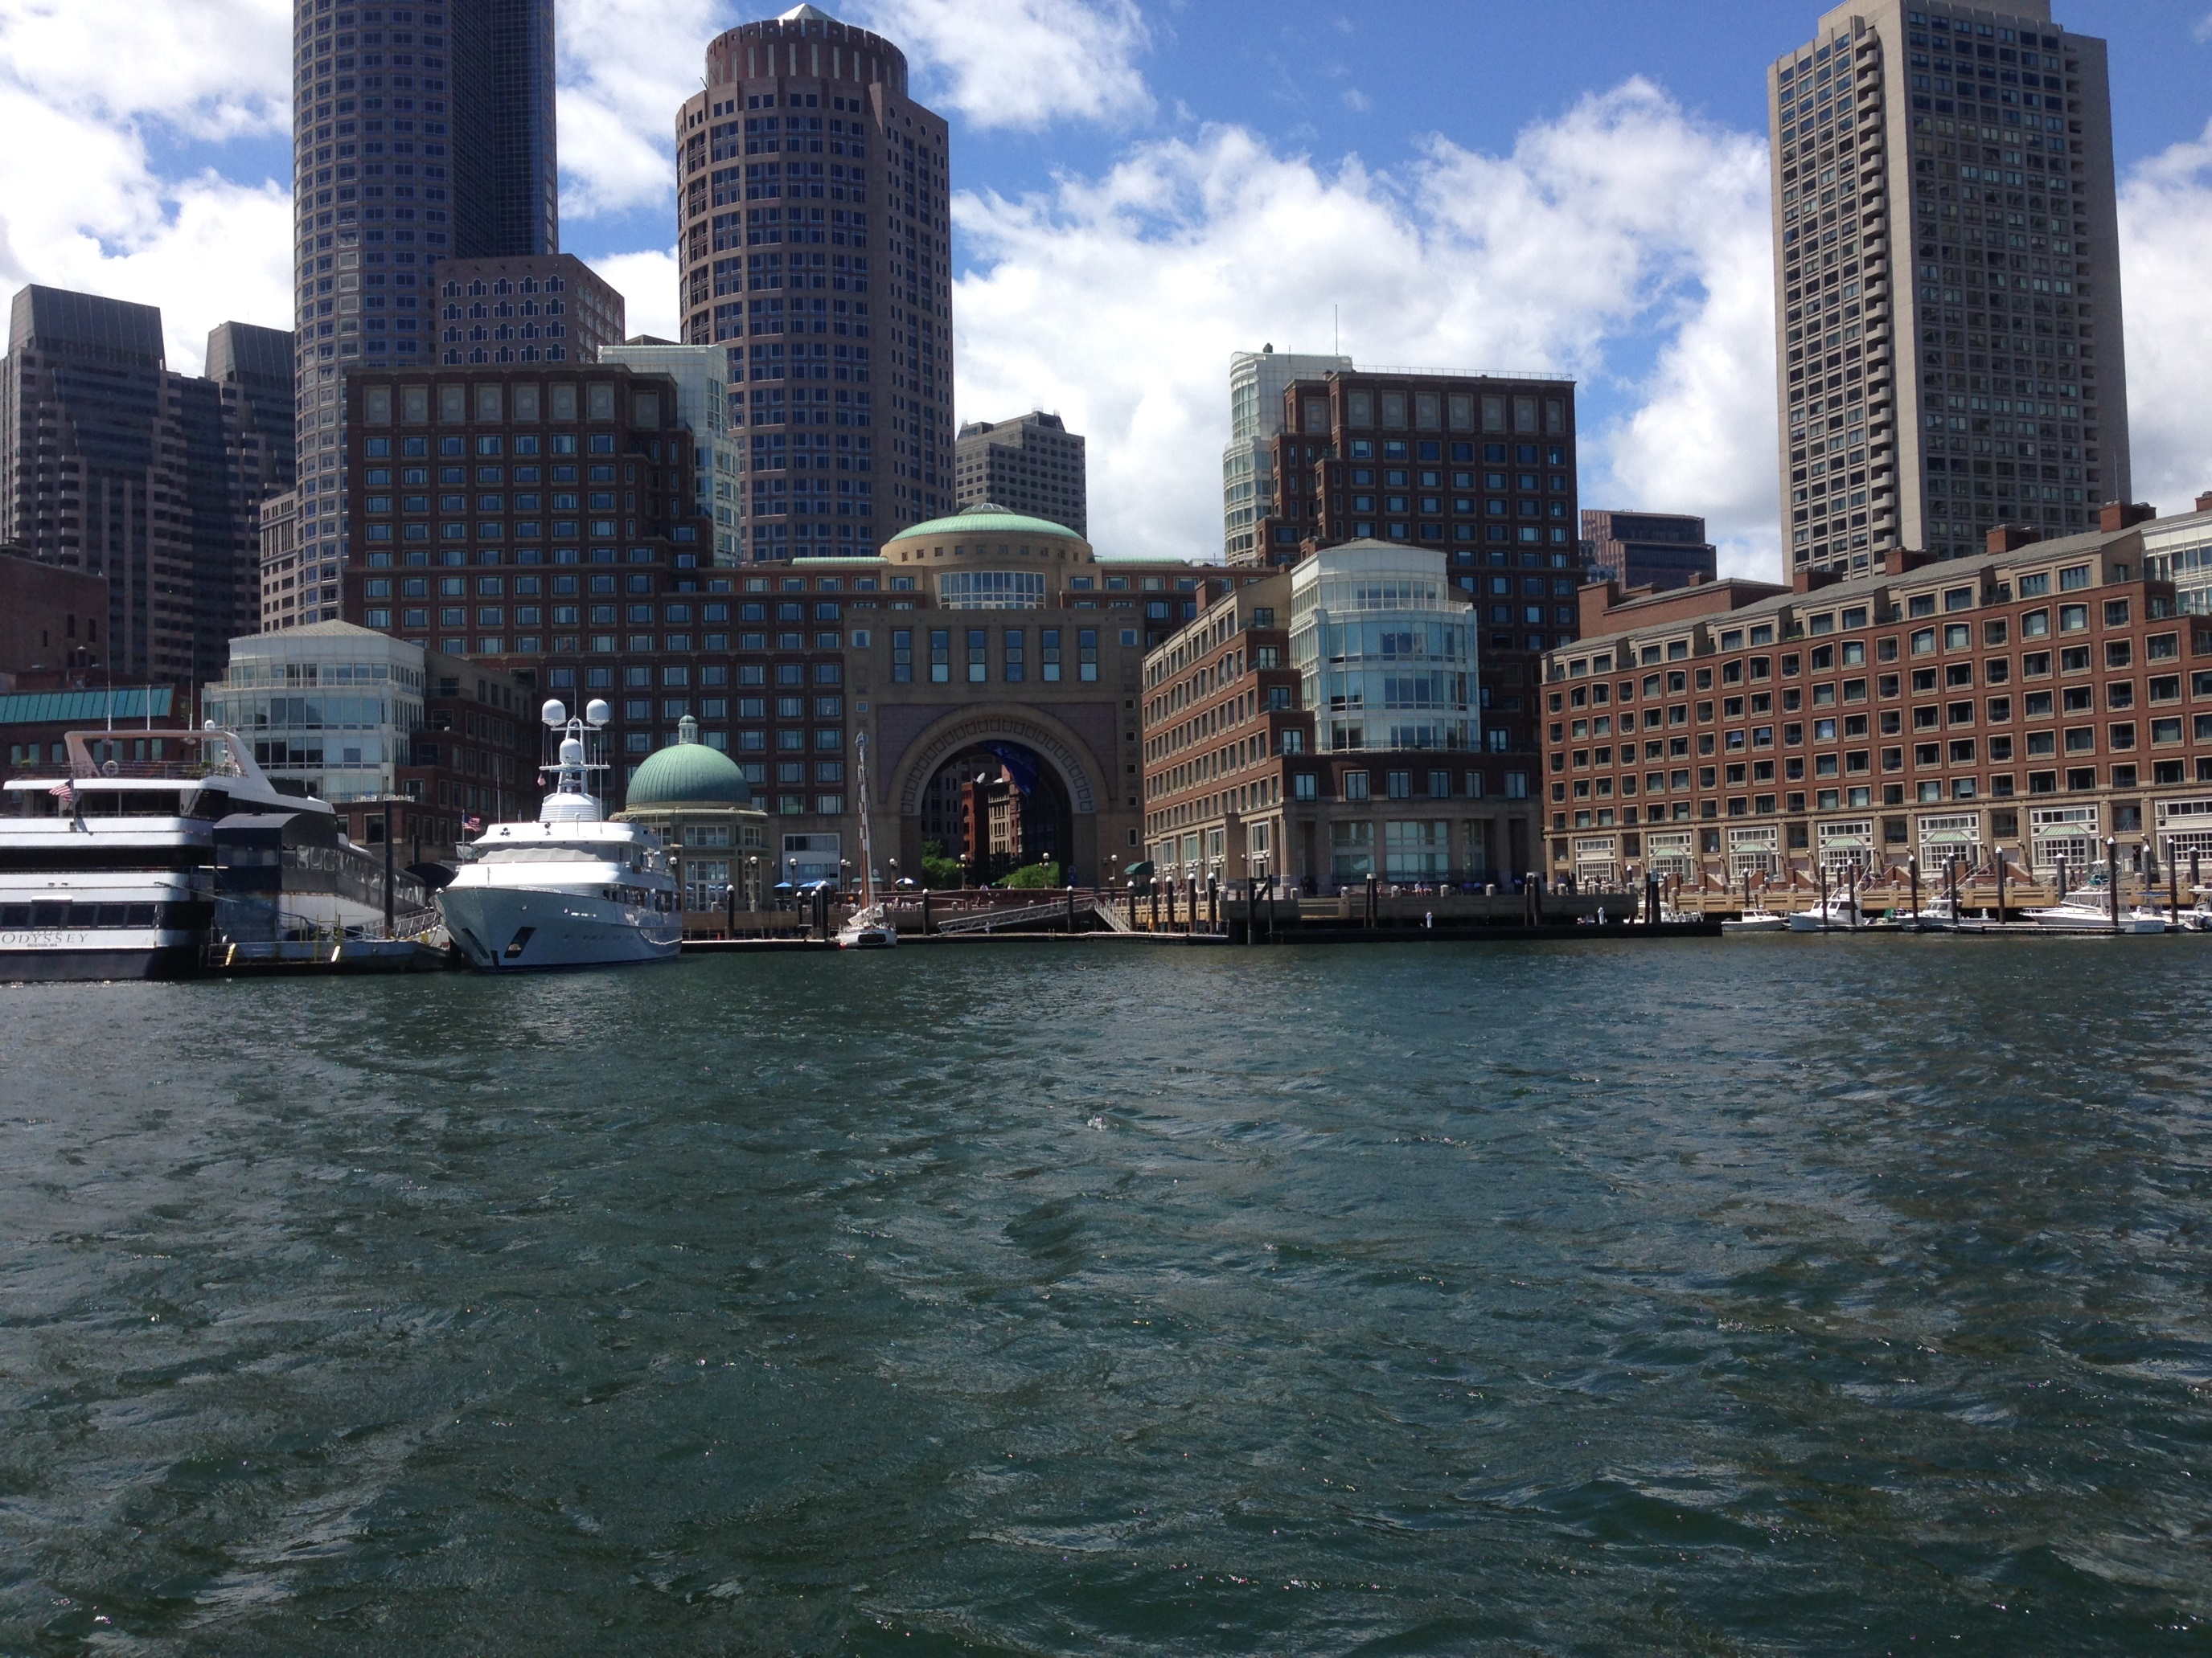

Slide 15
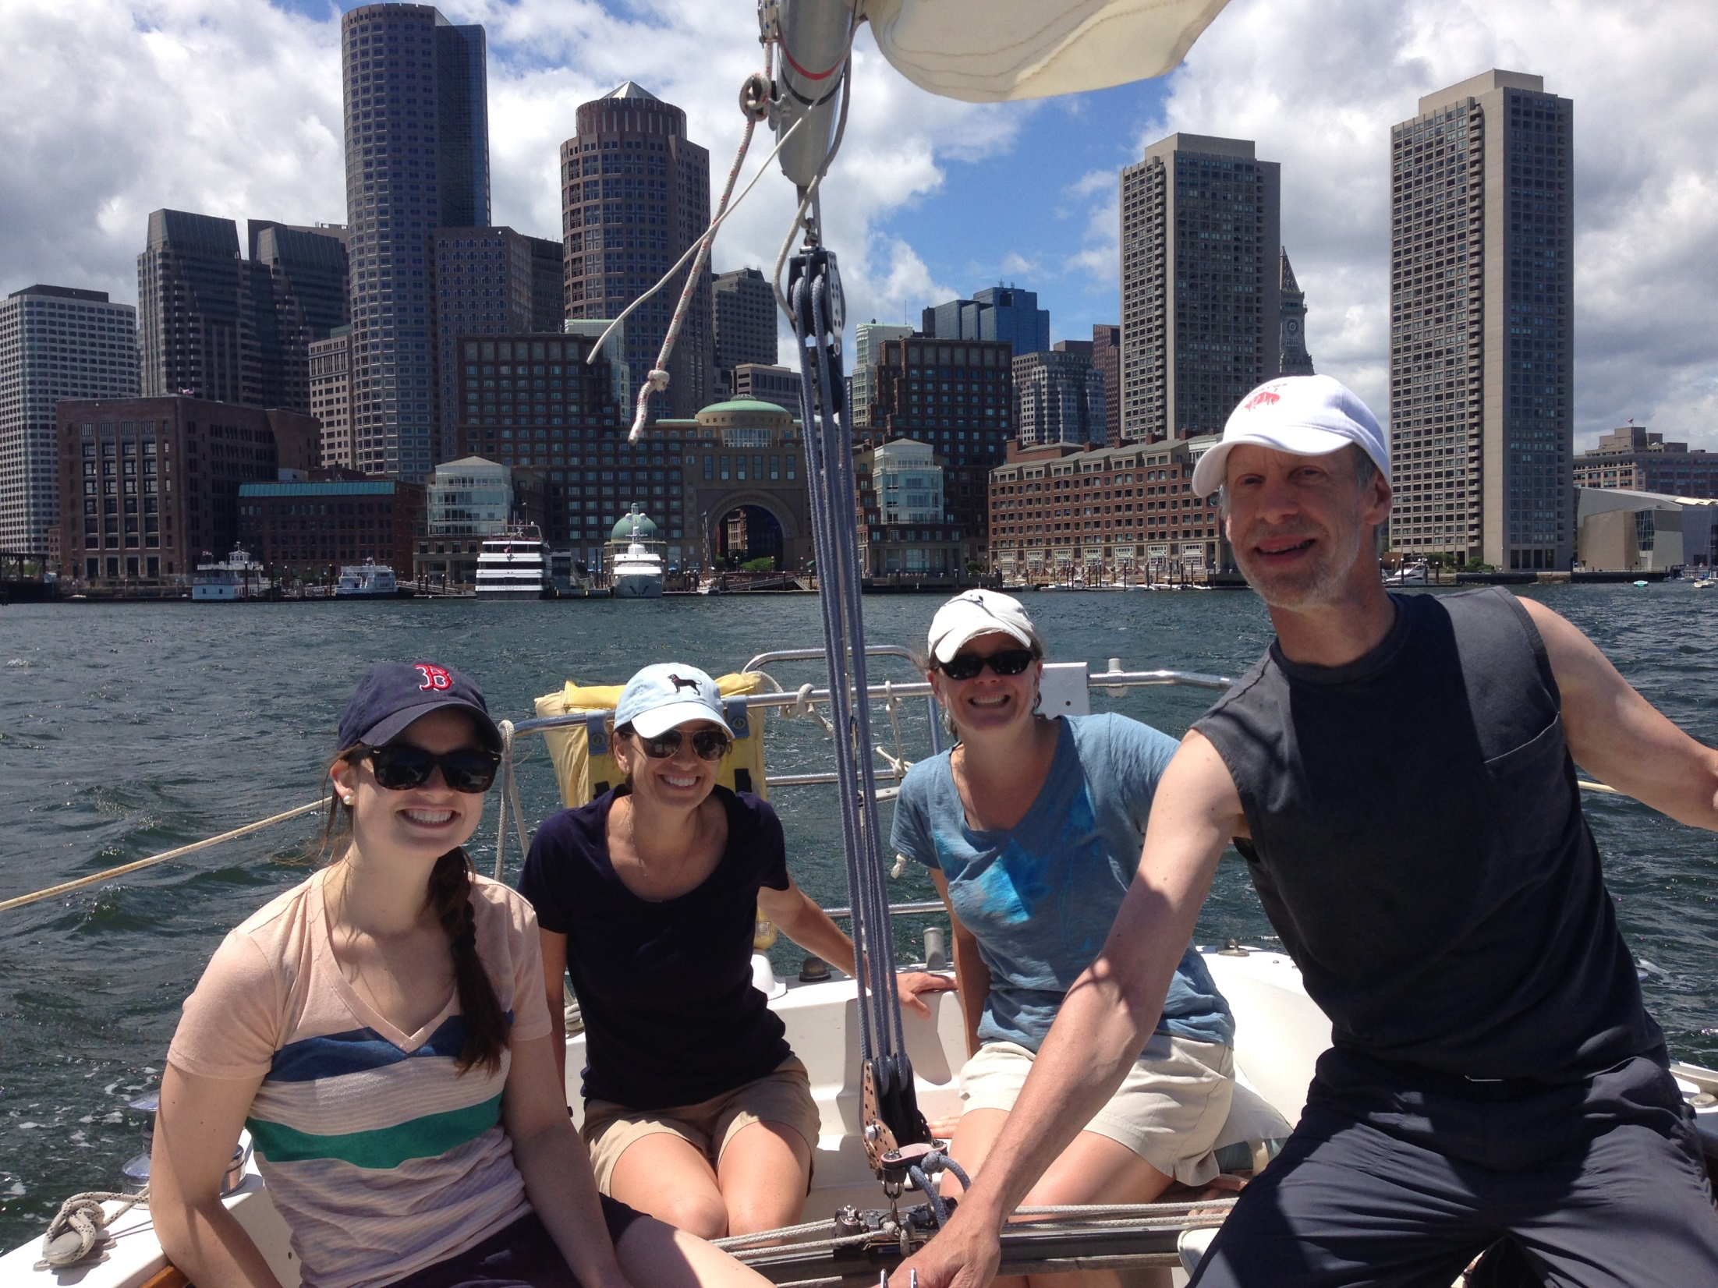

Slide 16
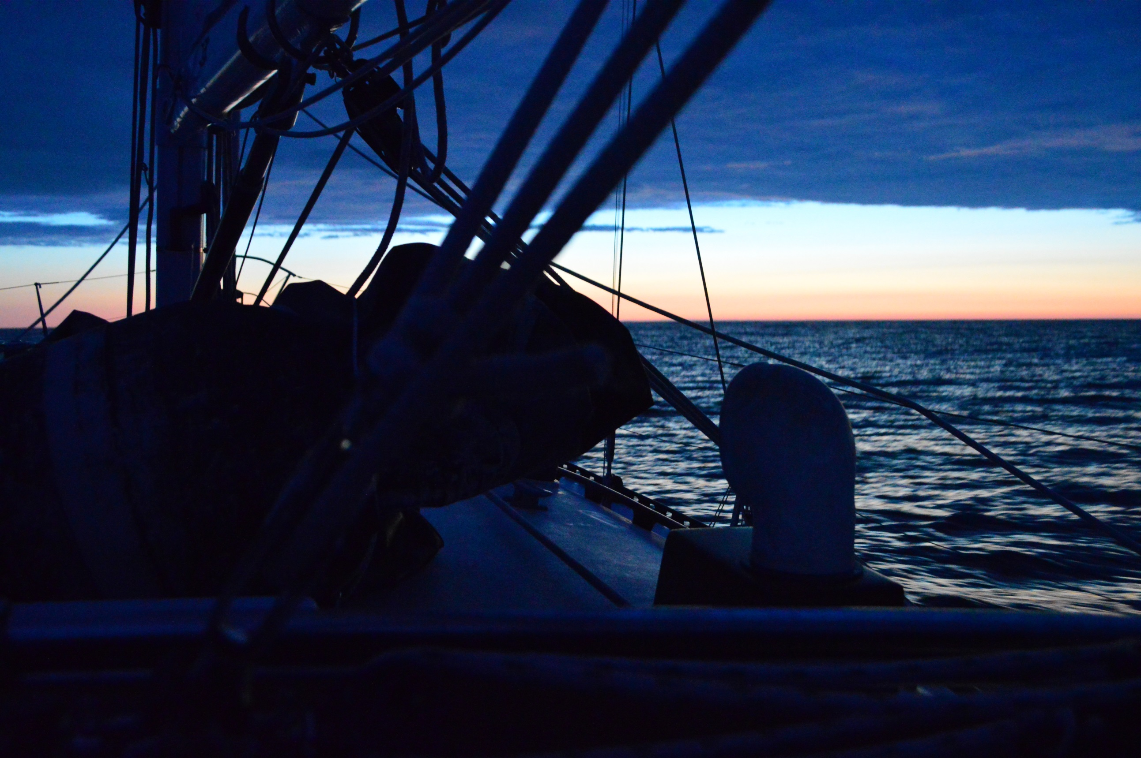

Slide 17
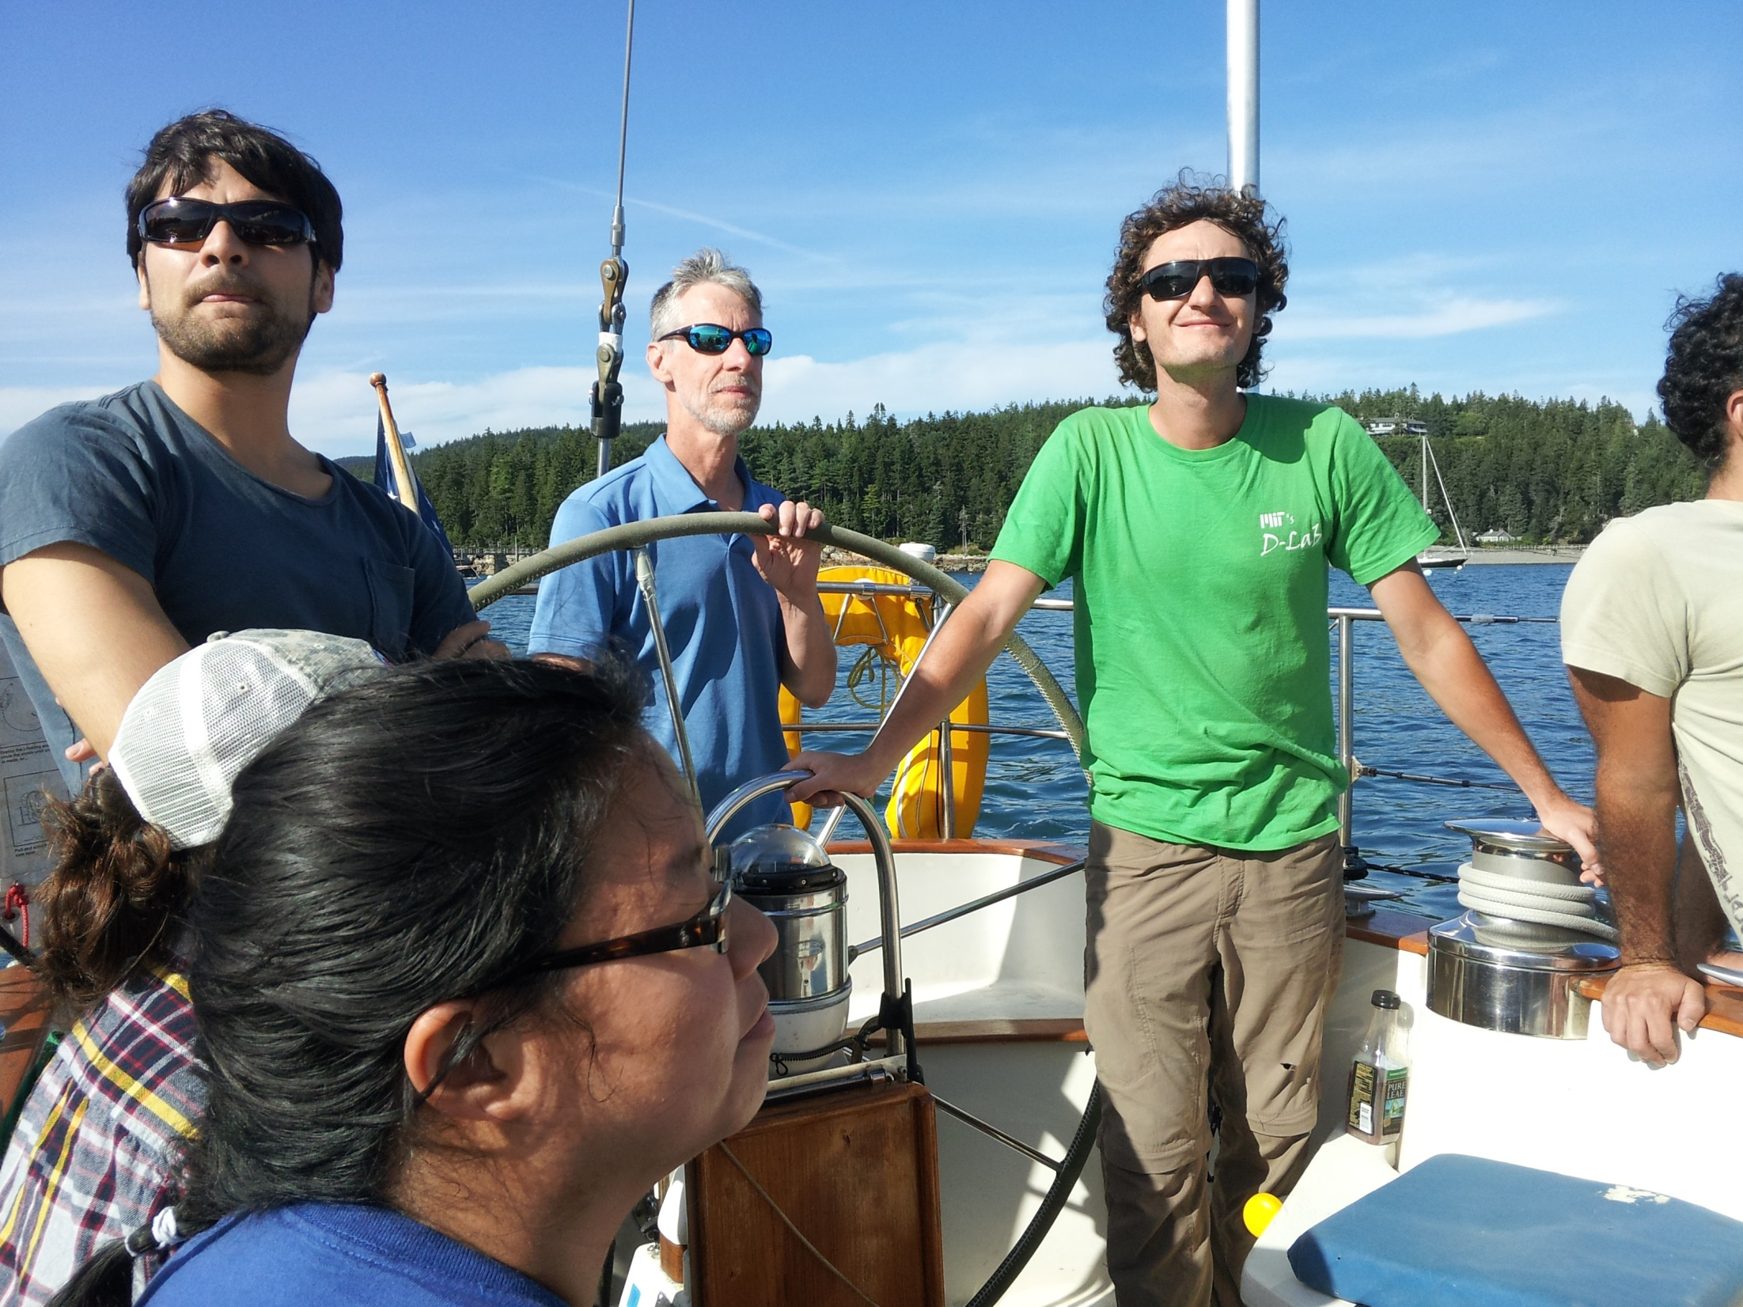

Slide 18
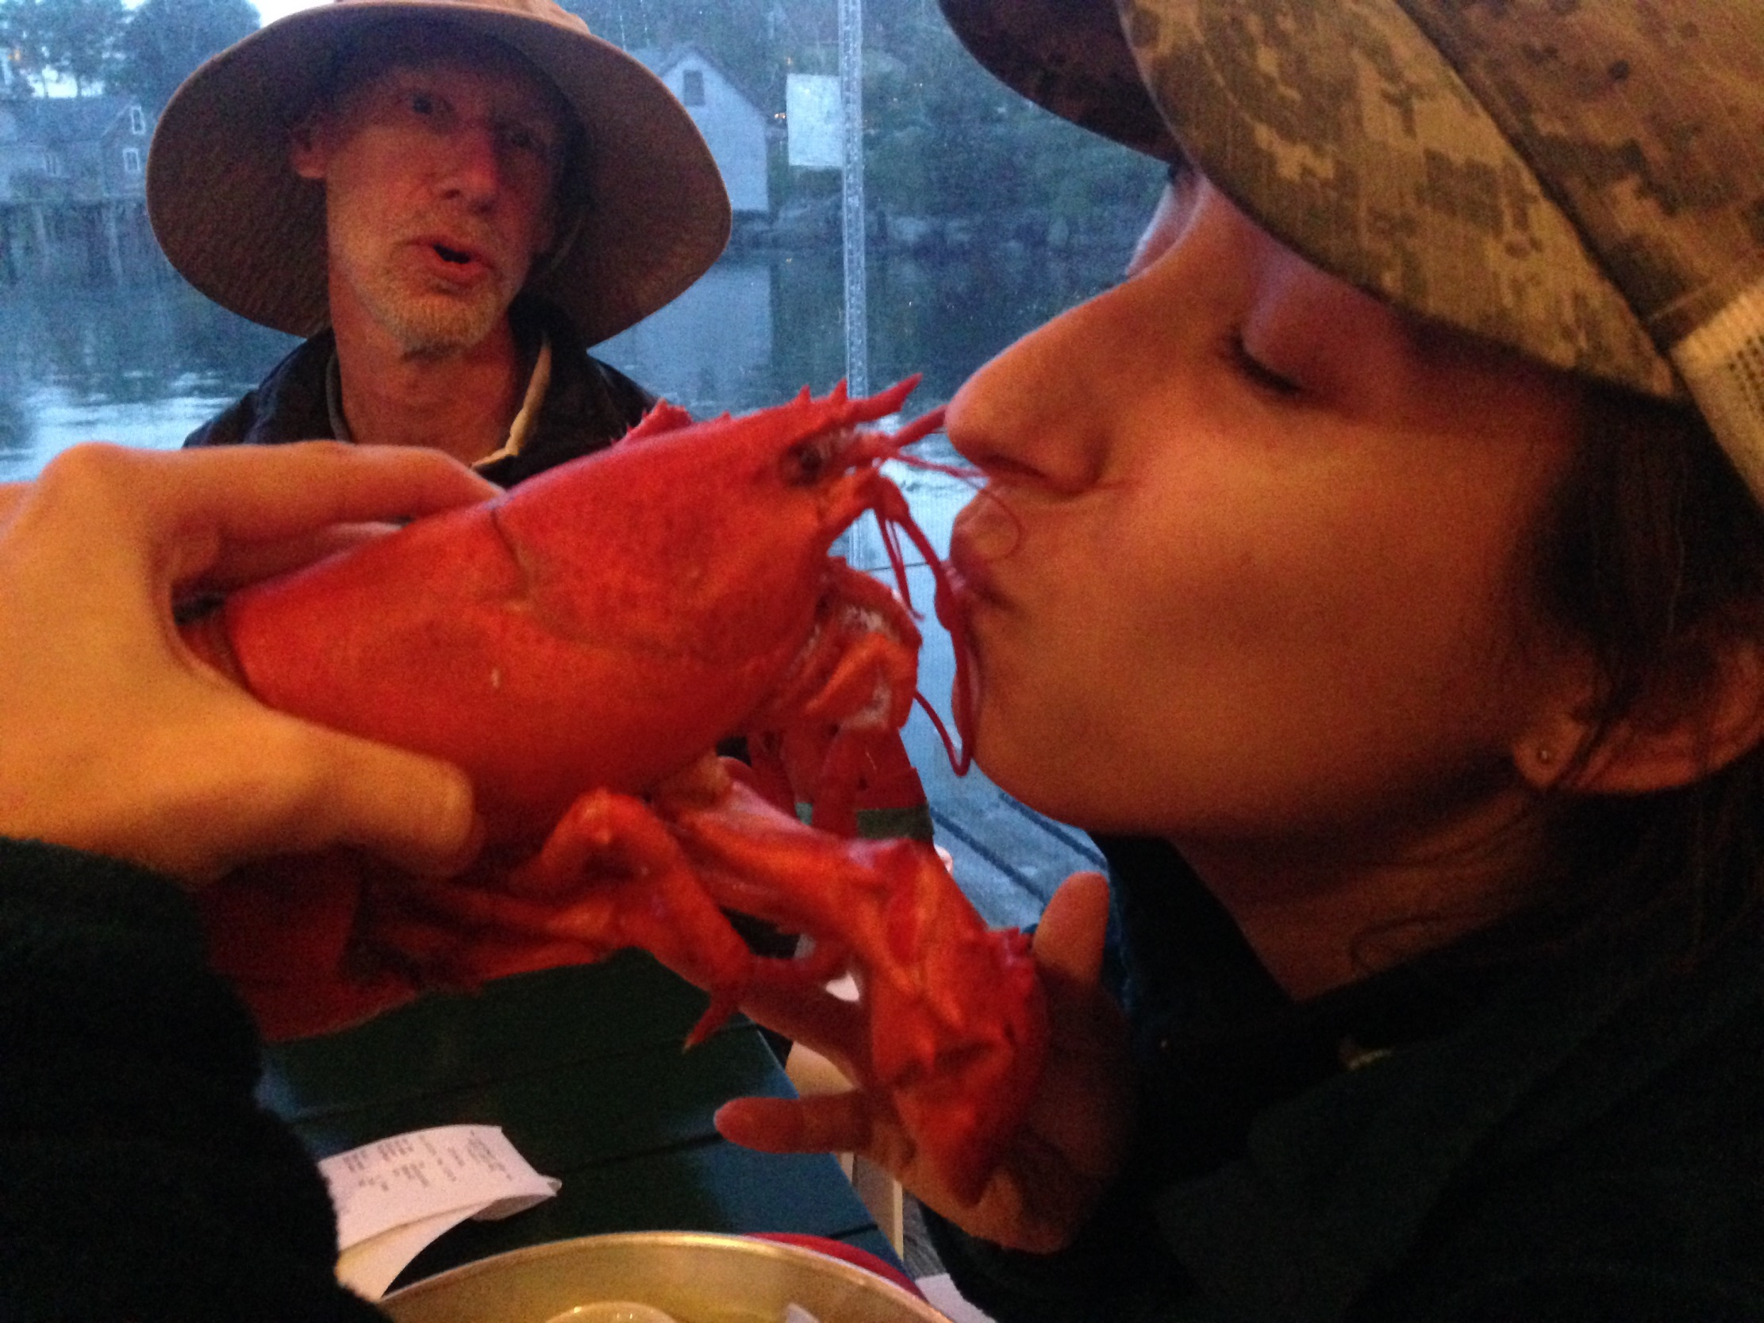

Slide 19
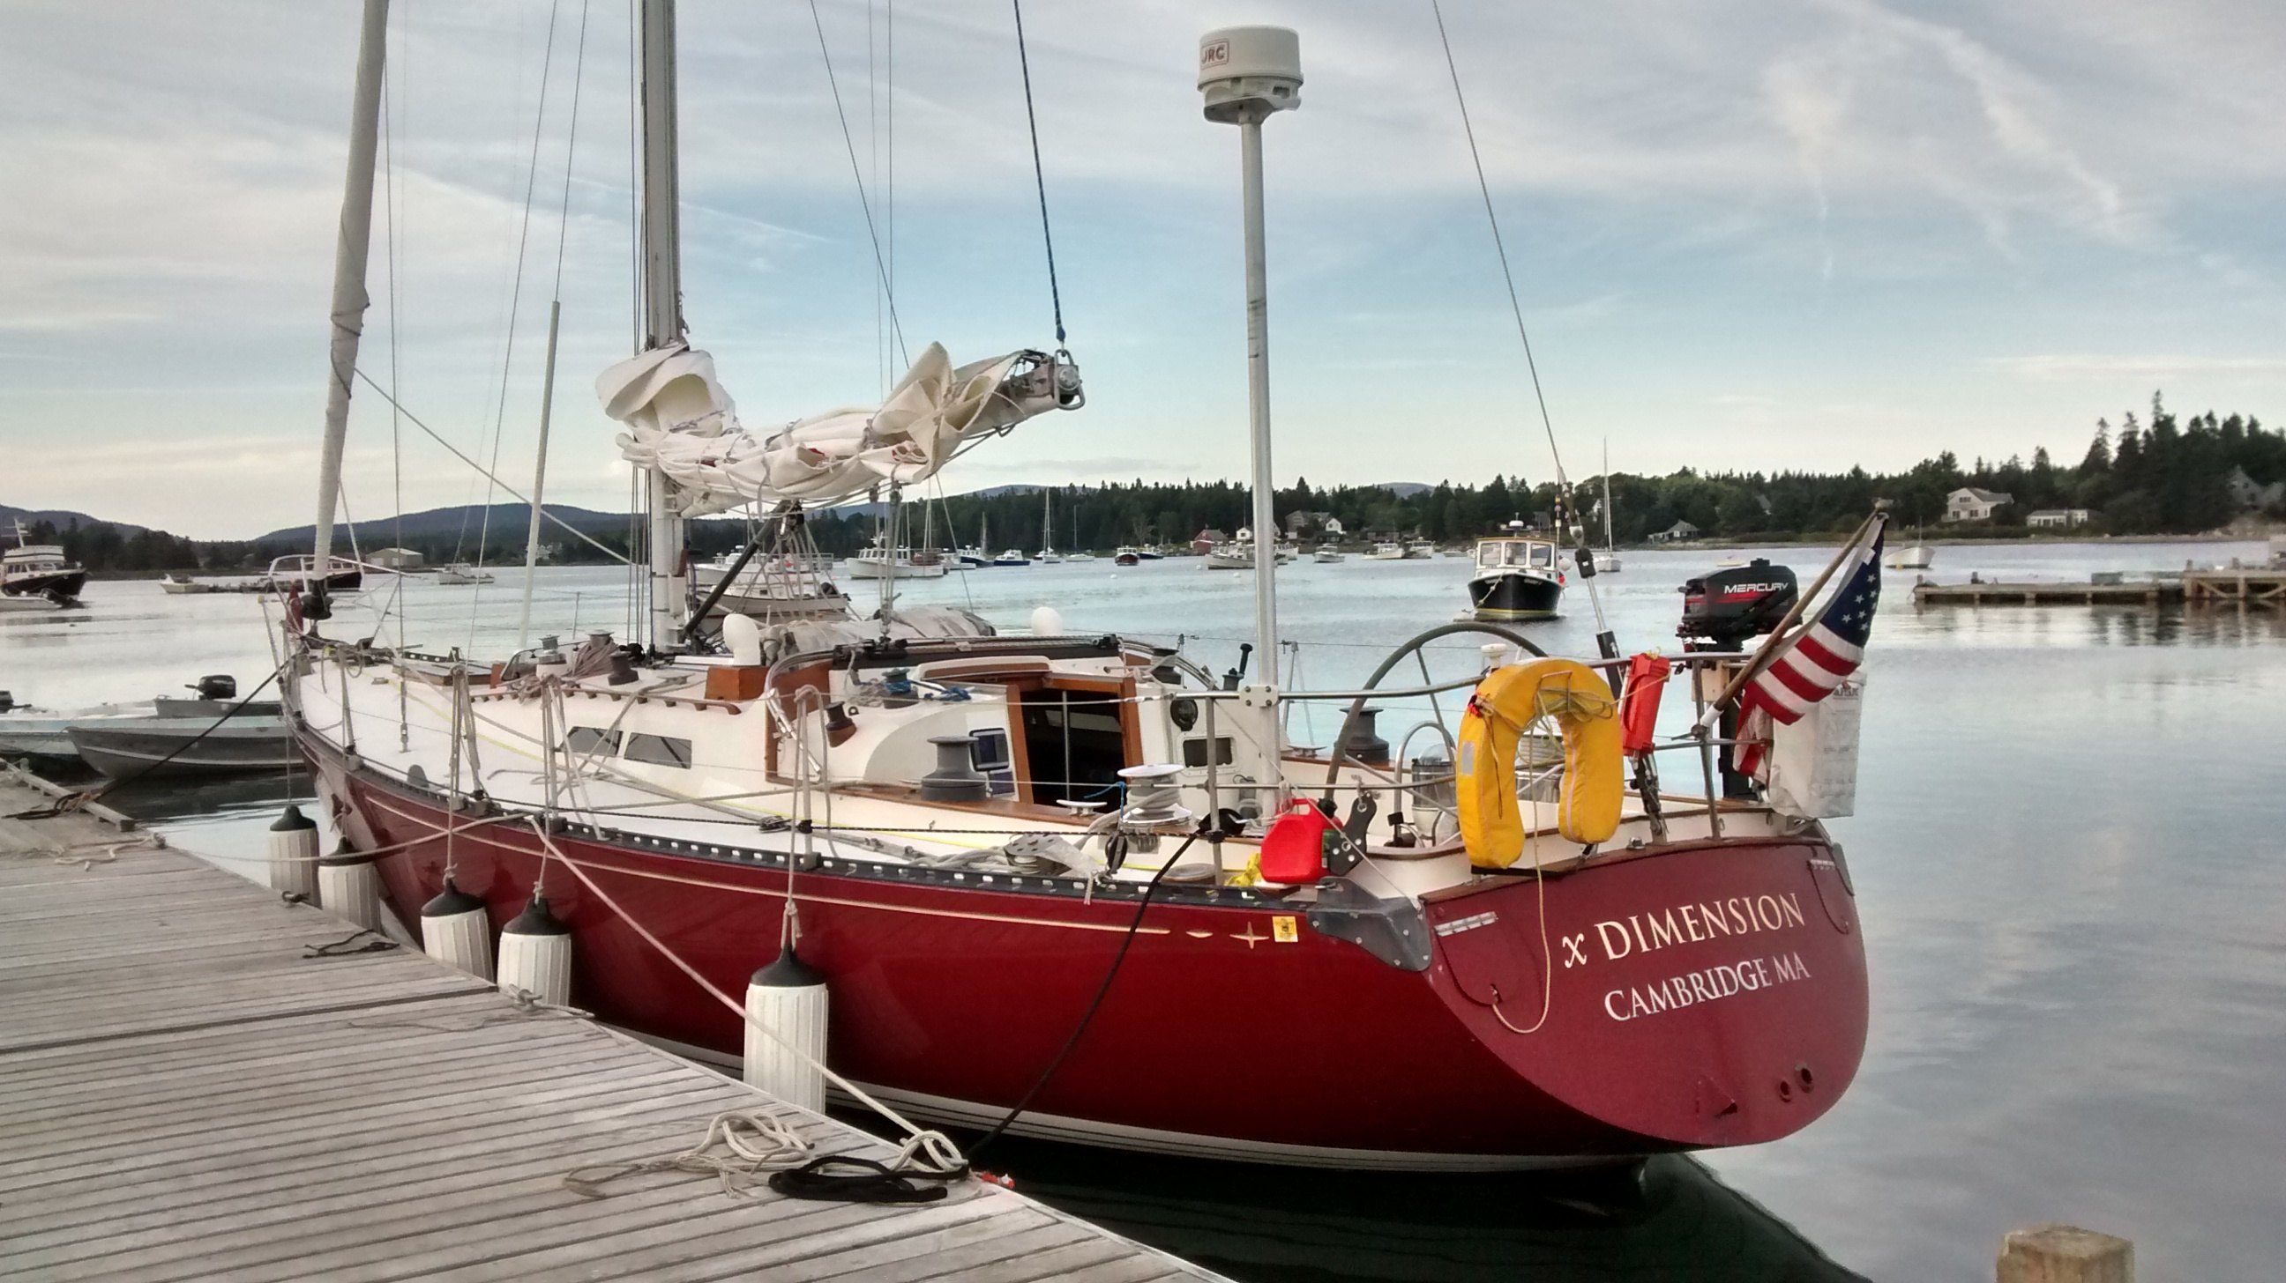

Slide 20
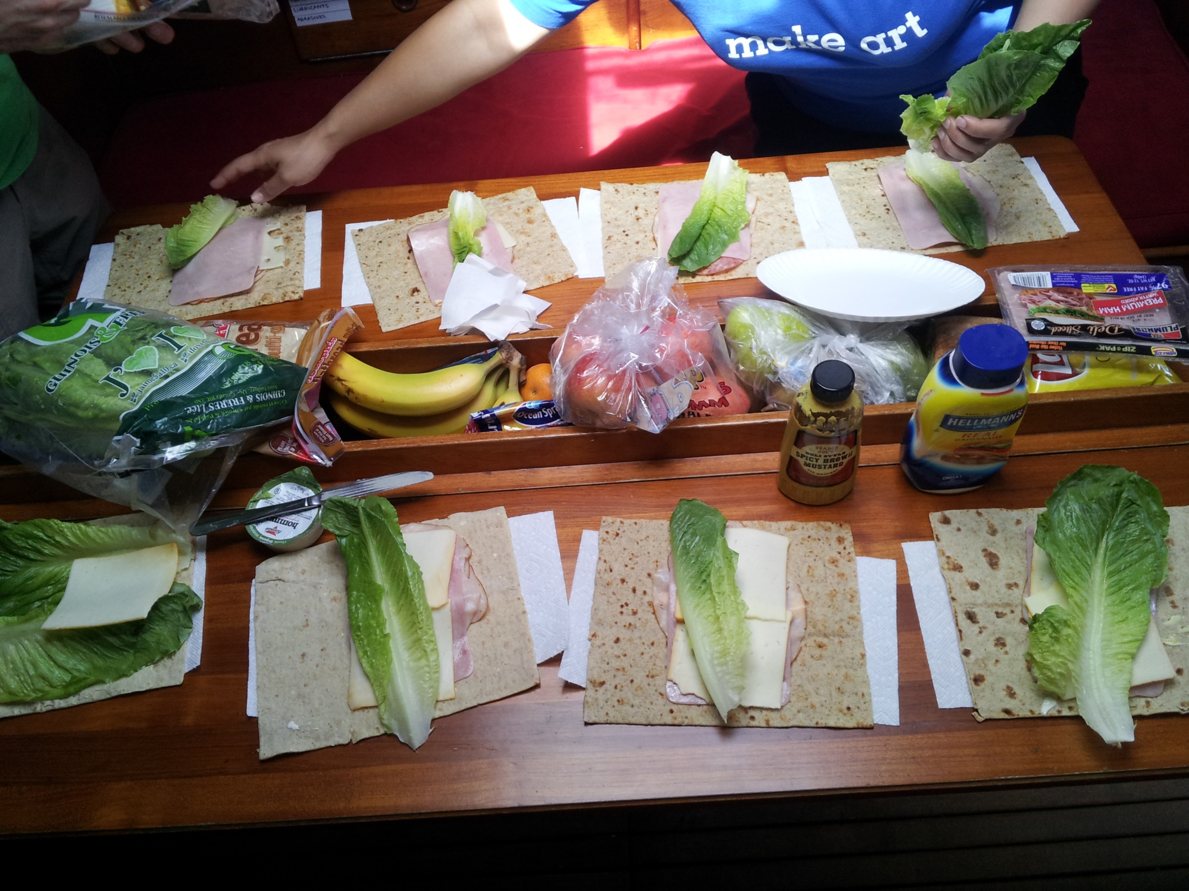

Slide 21
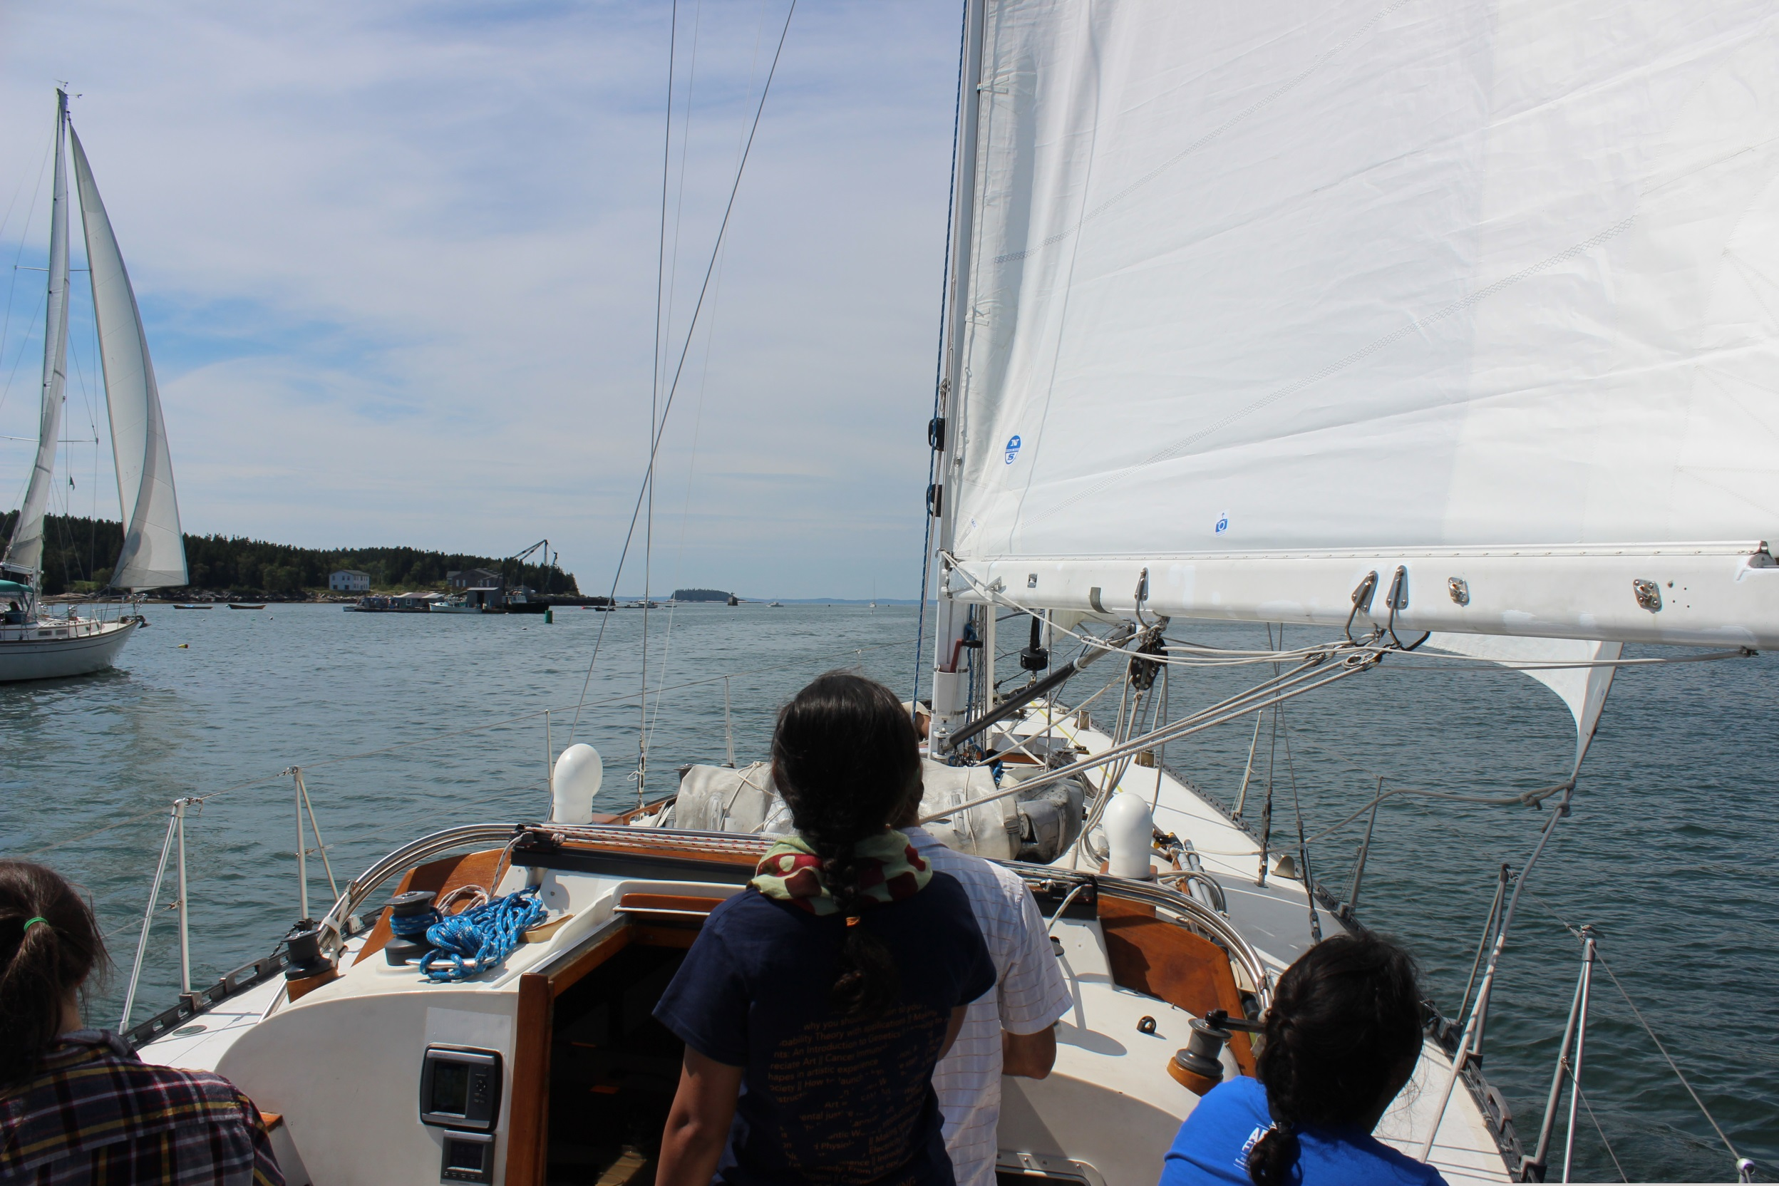

Slide 22
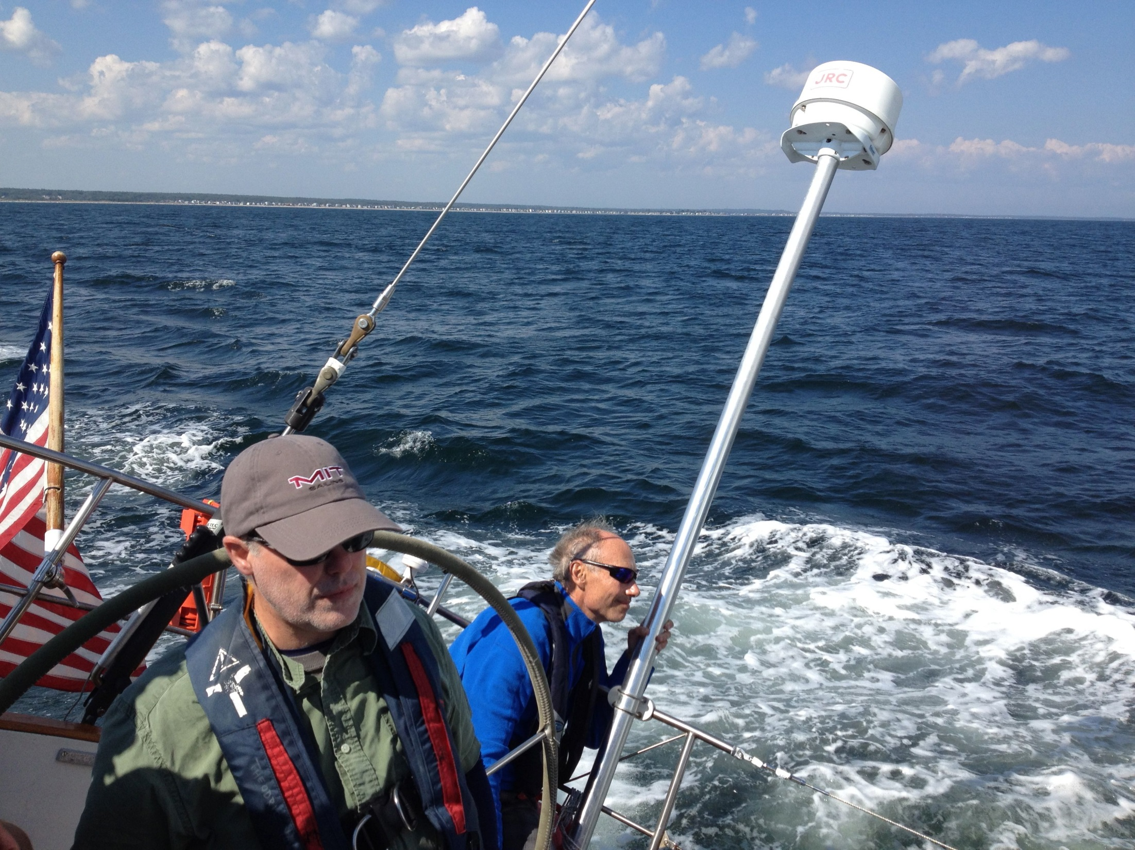

Slide 23
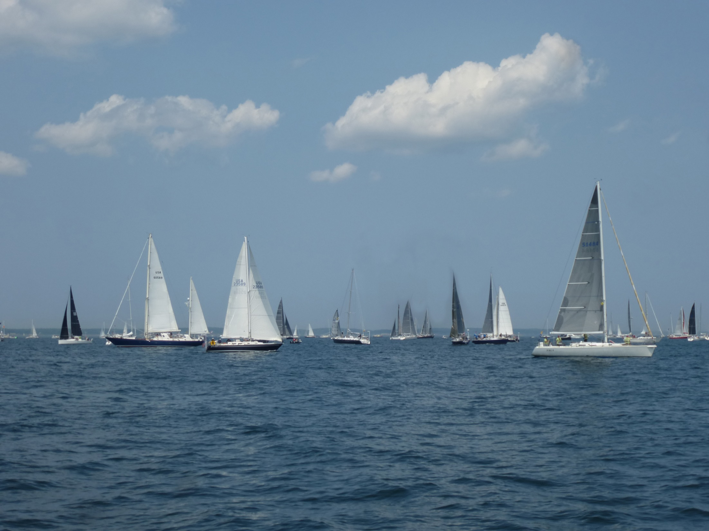

Slide 24
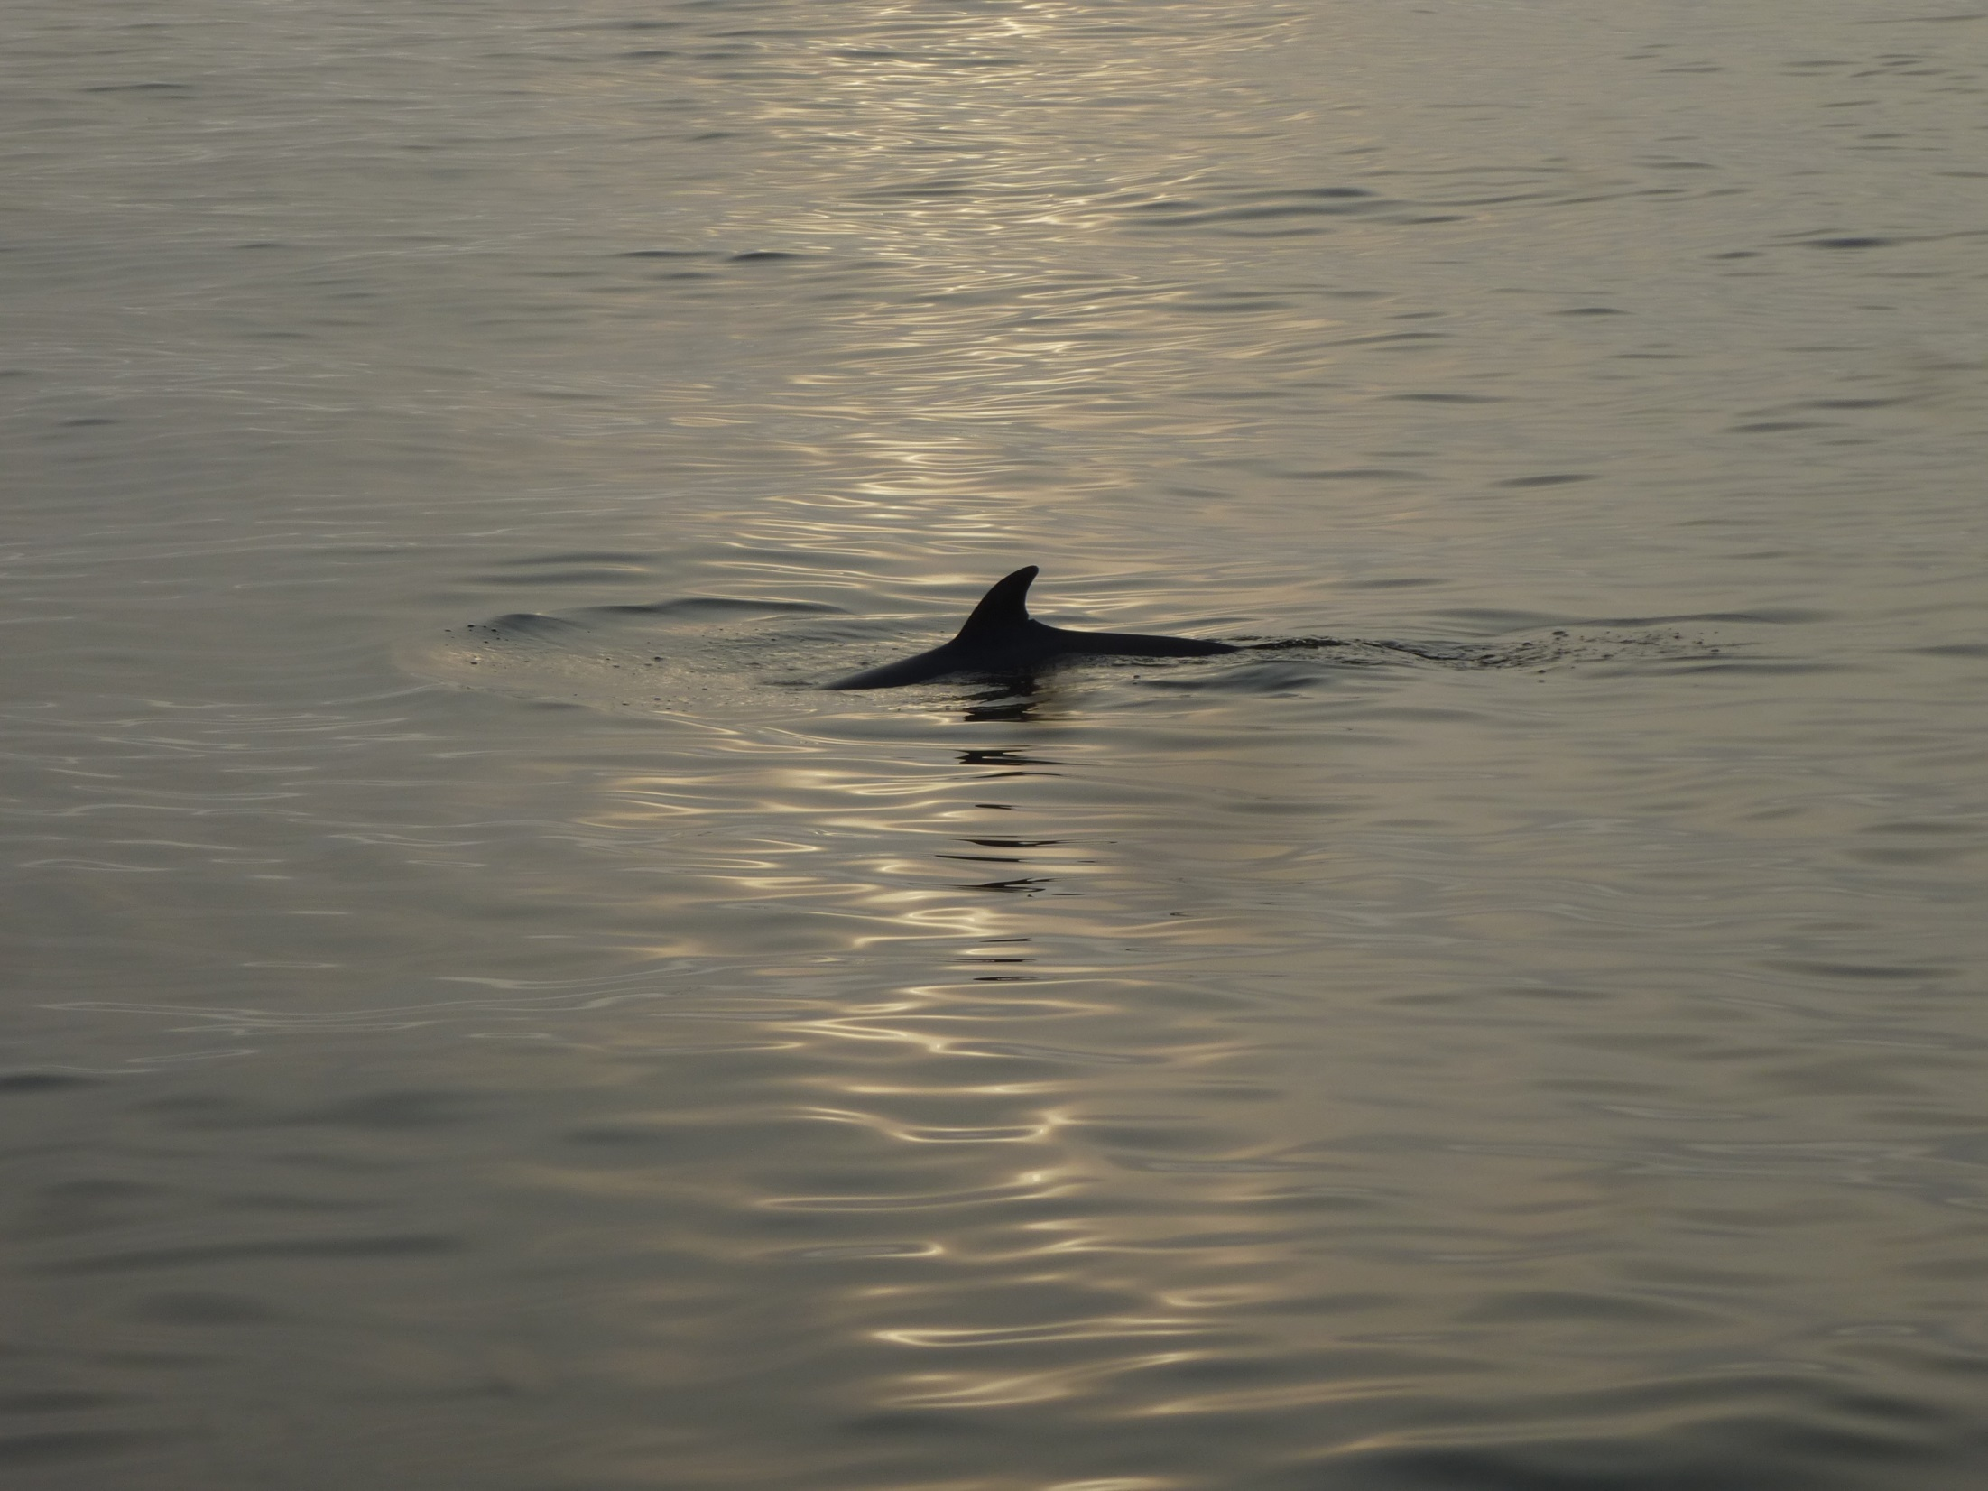

Slide 25
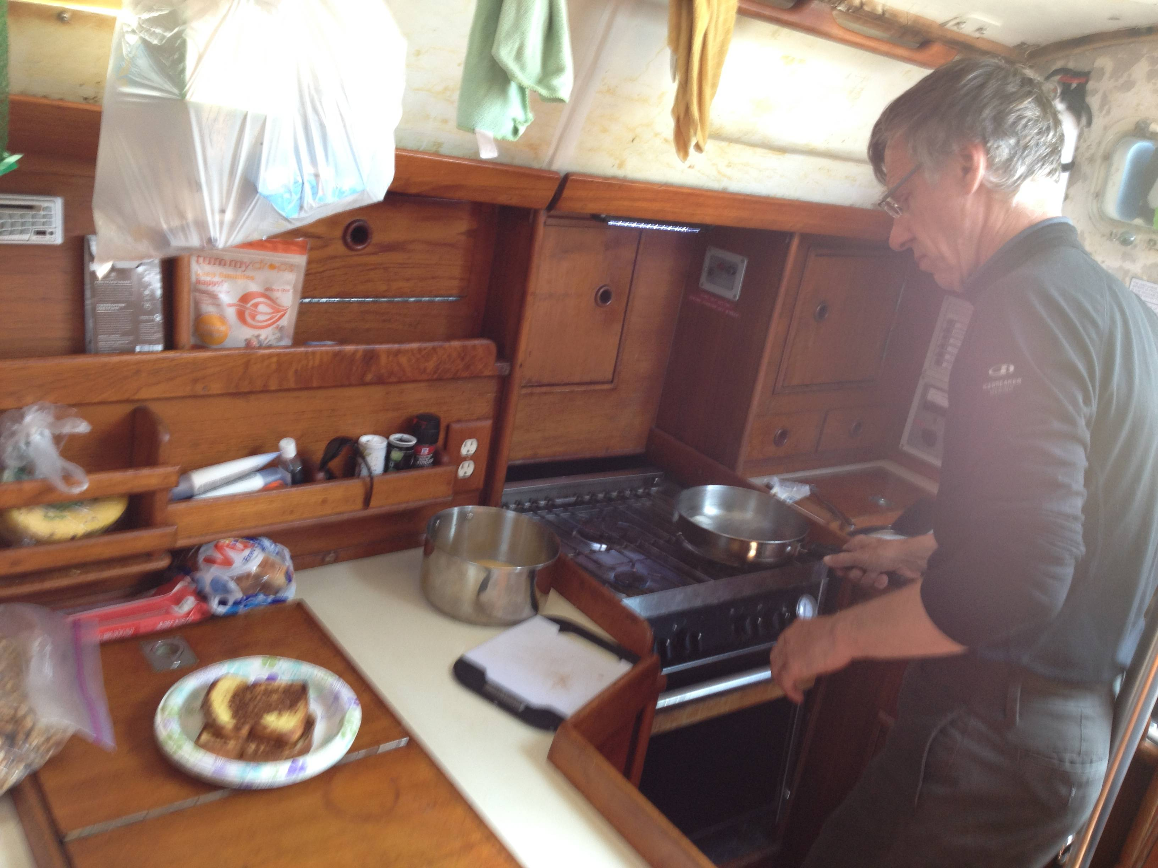

Slide 26
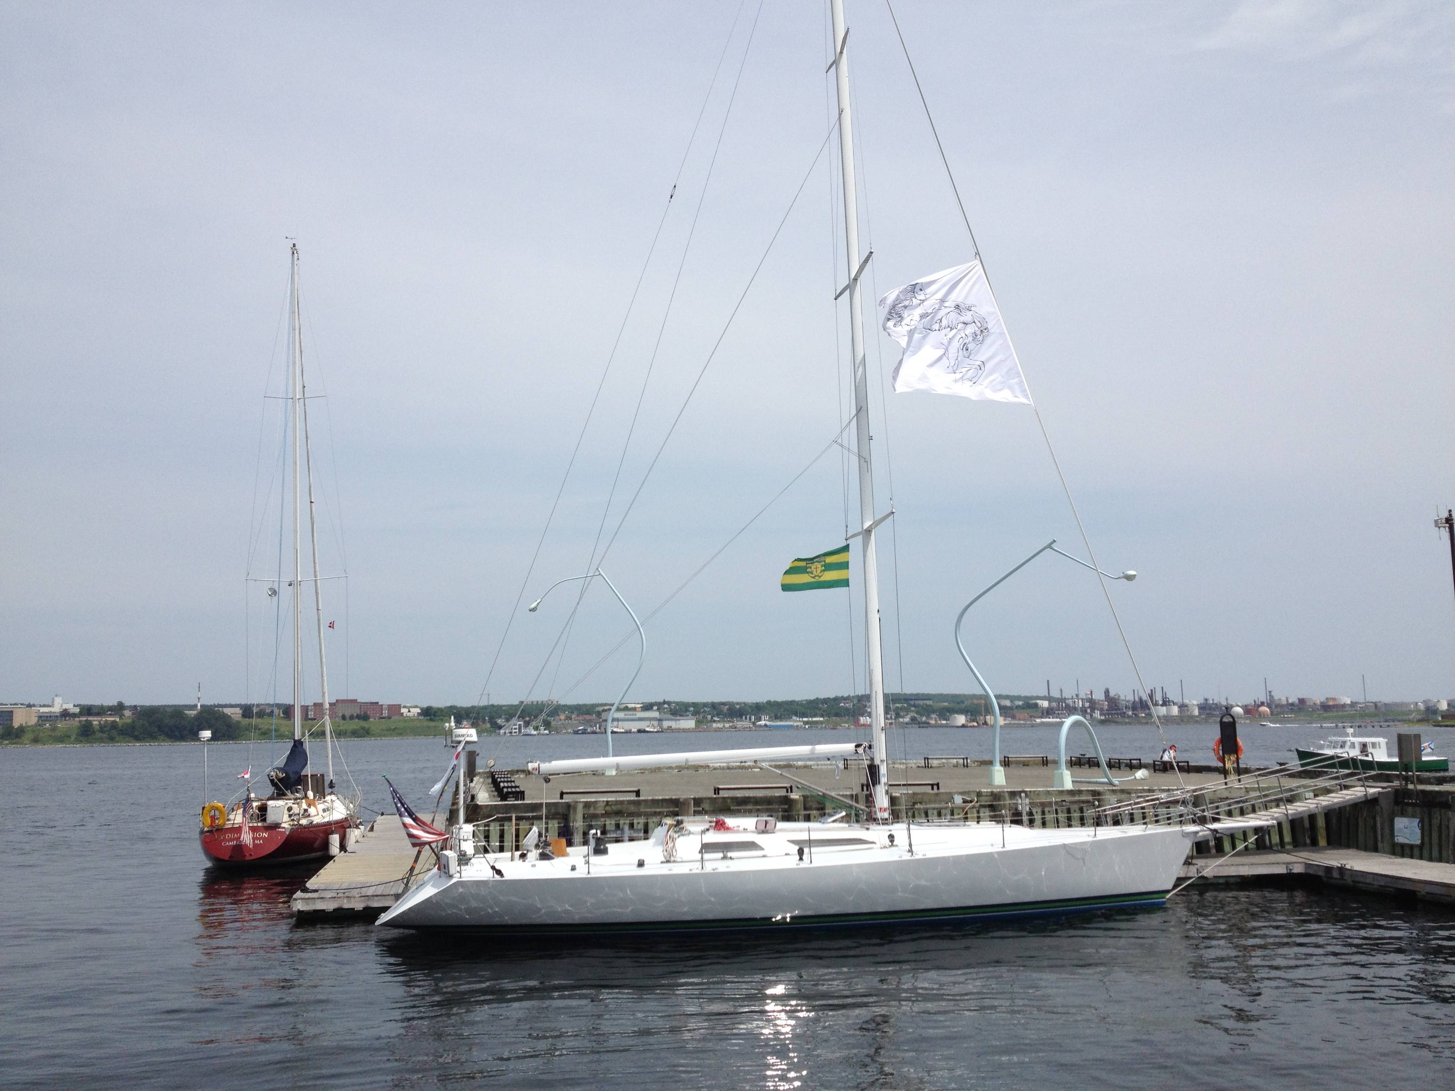

Slide 27
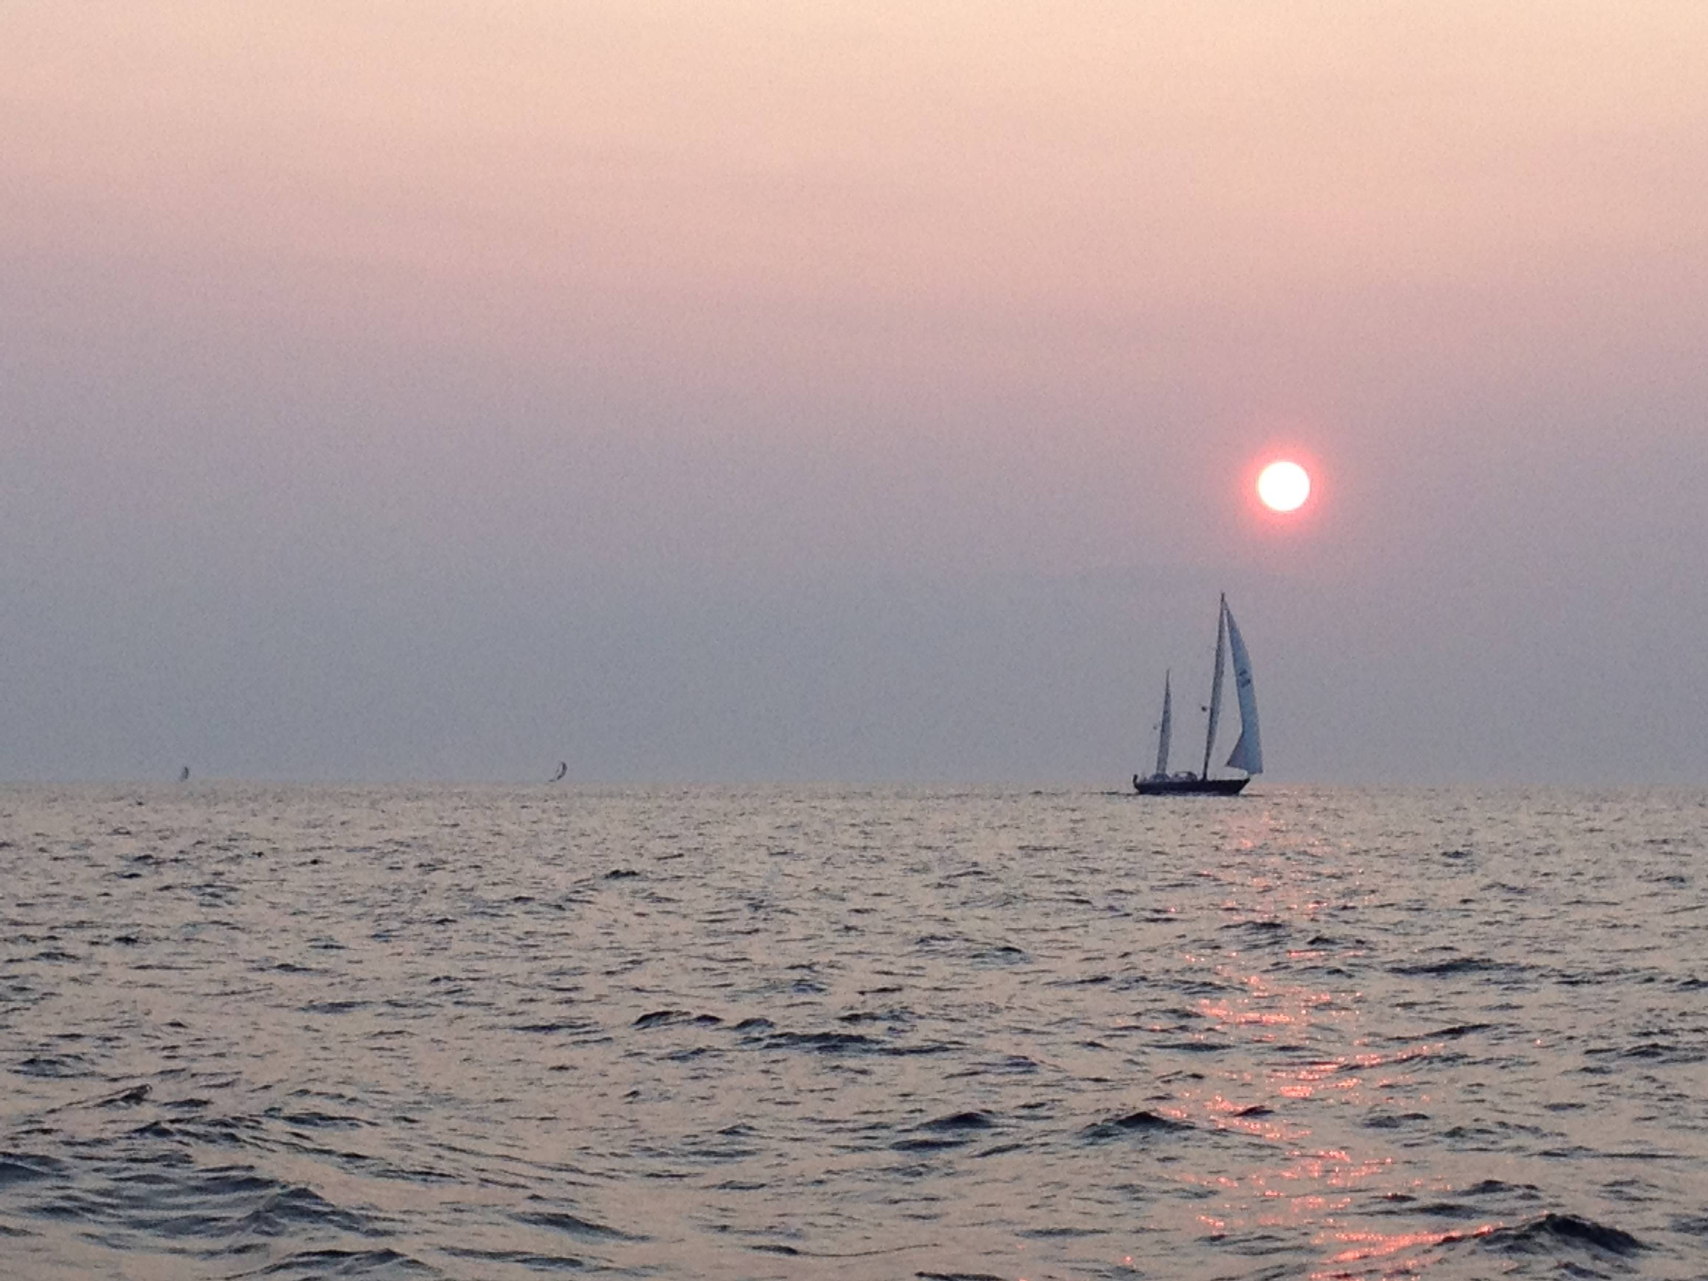

Slide 28
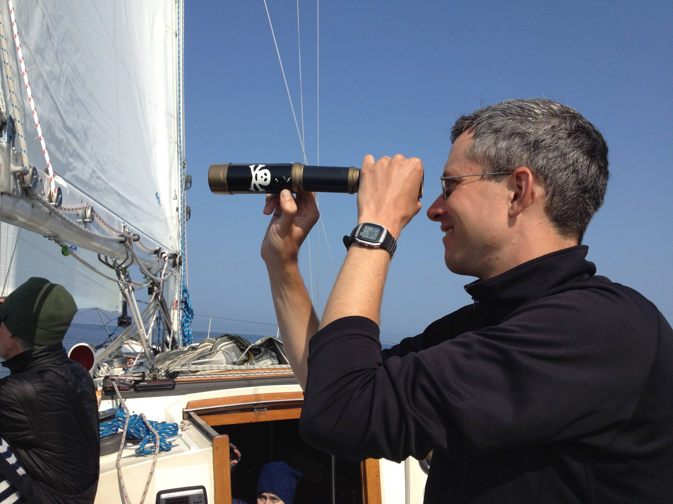

Slide 29
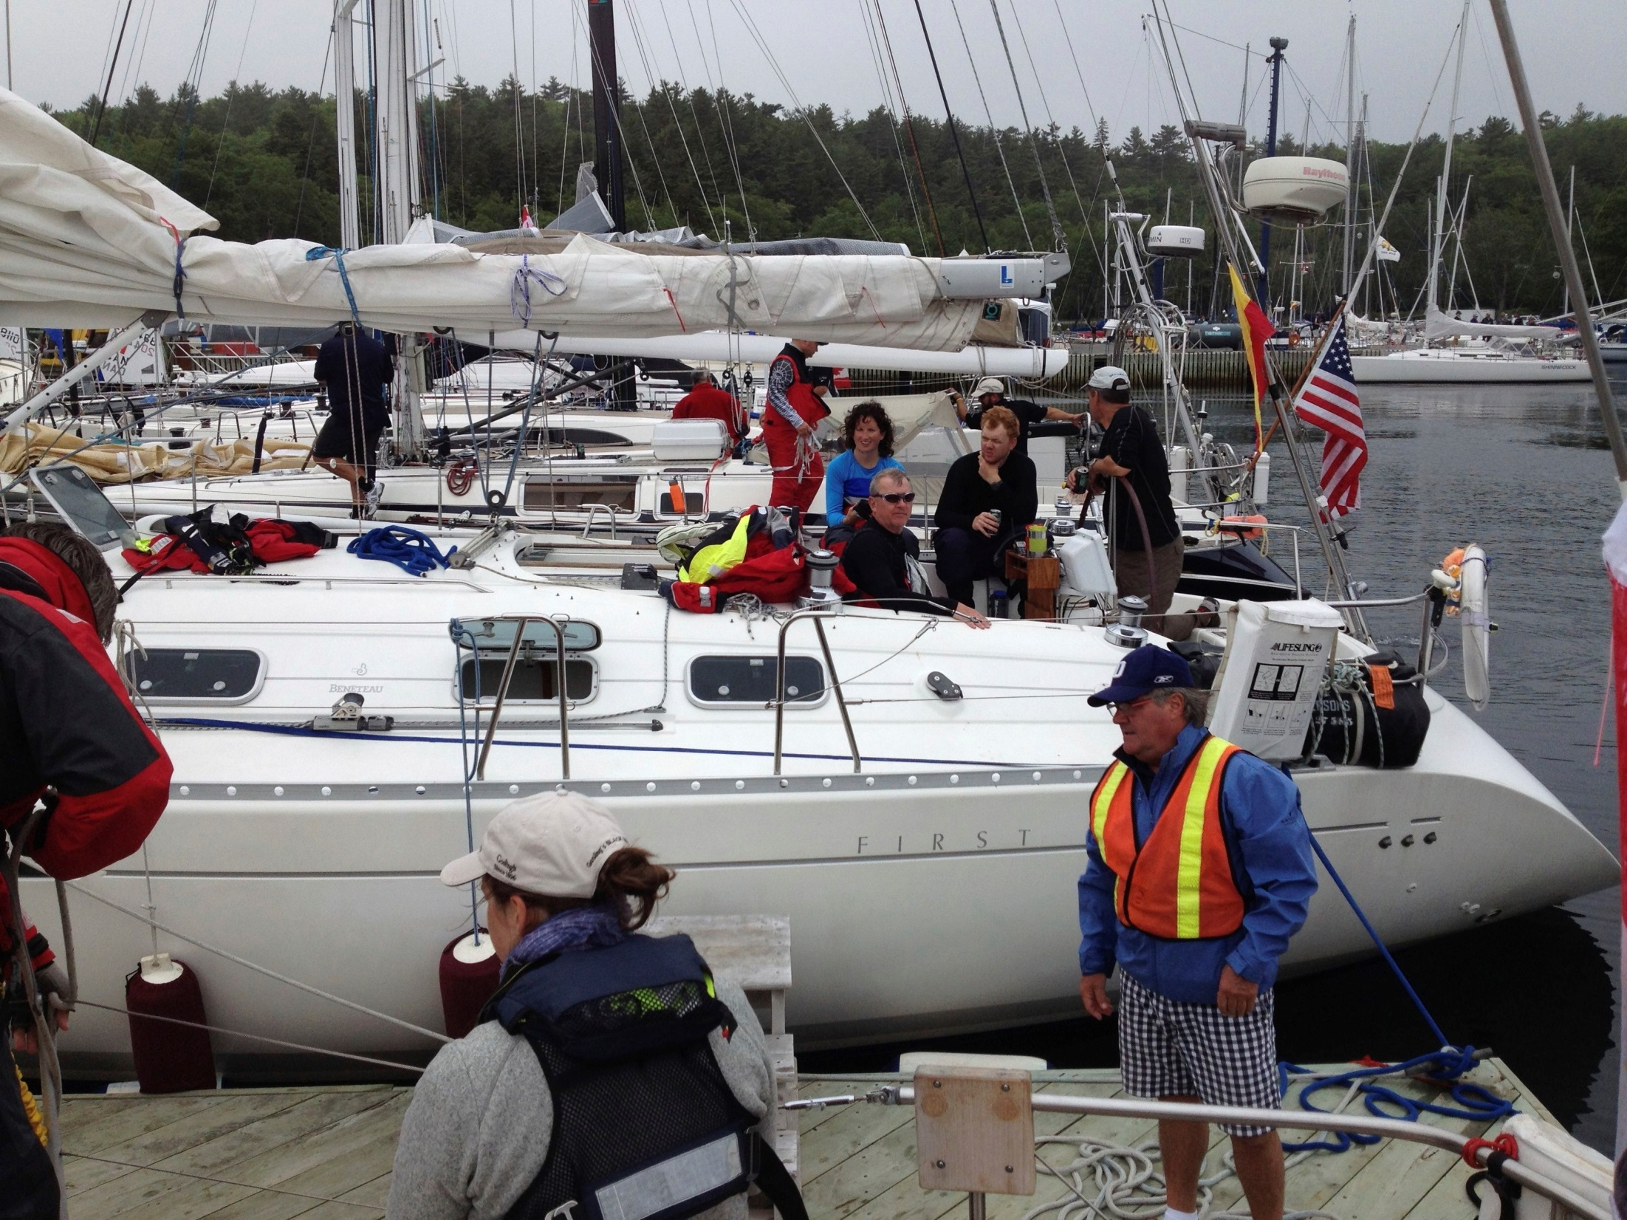

Slide 30
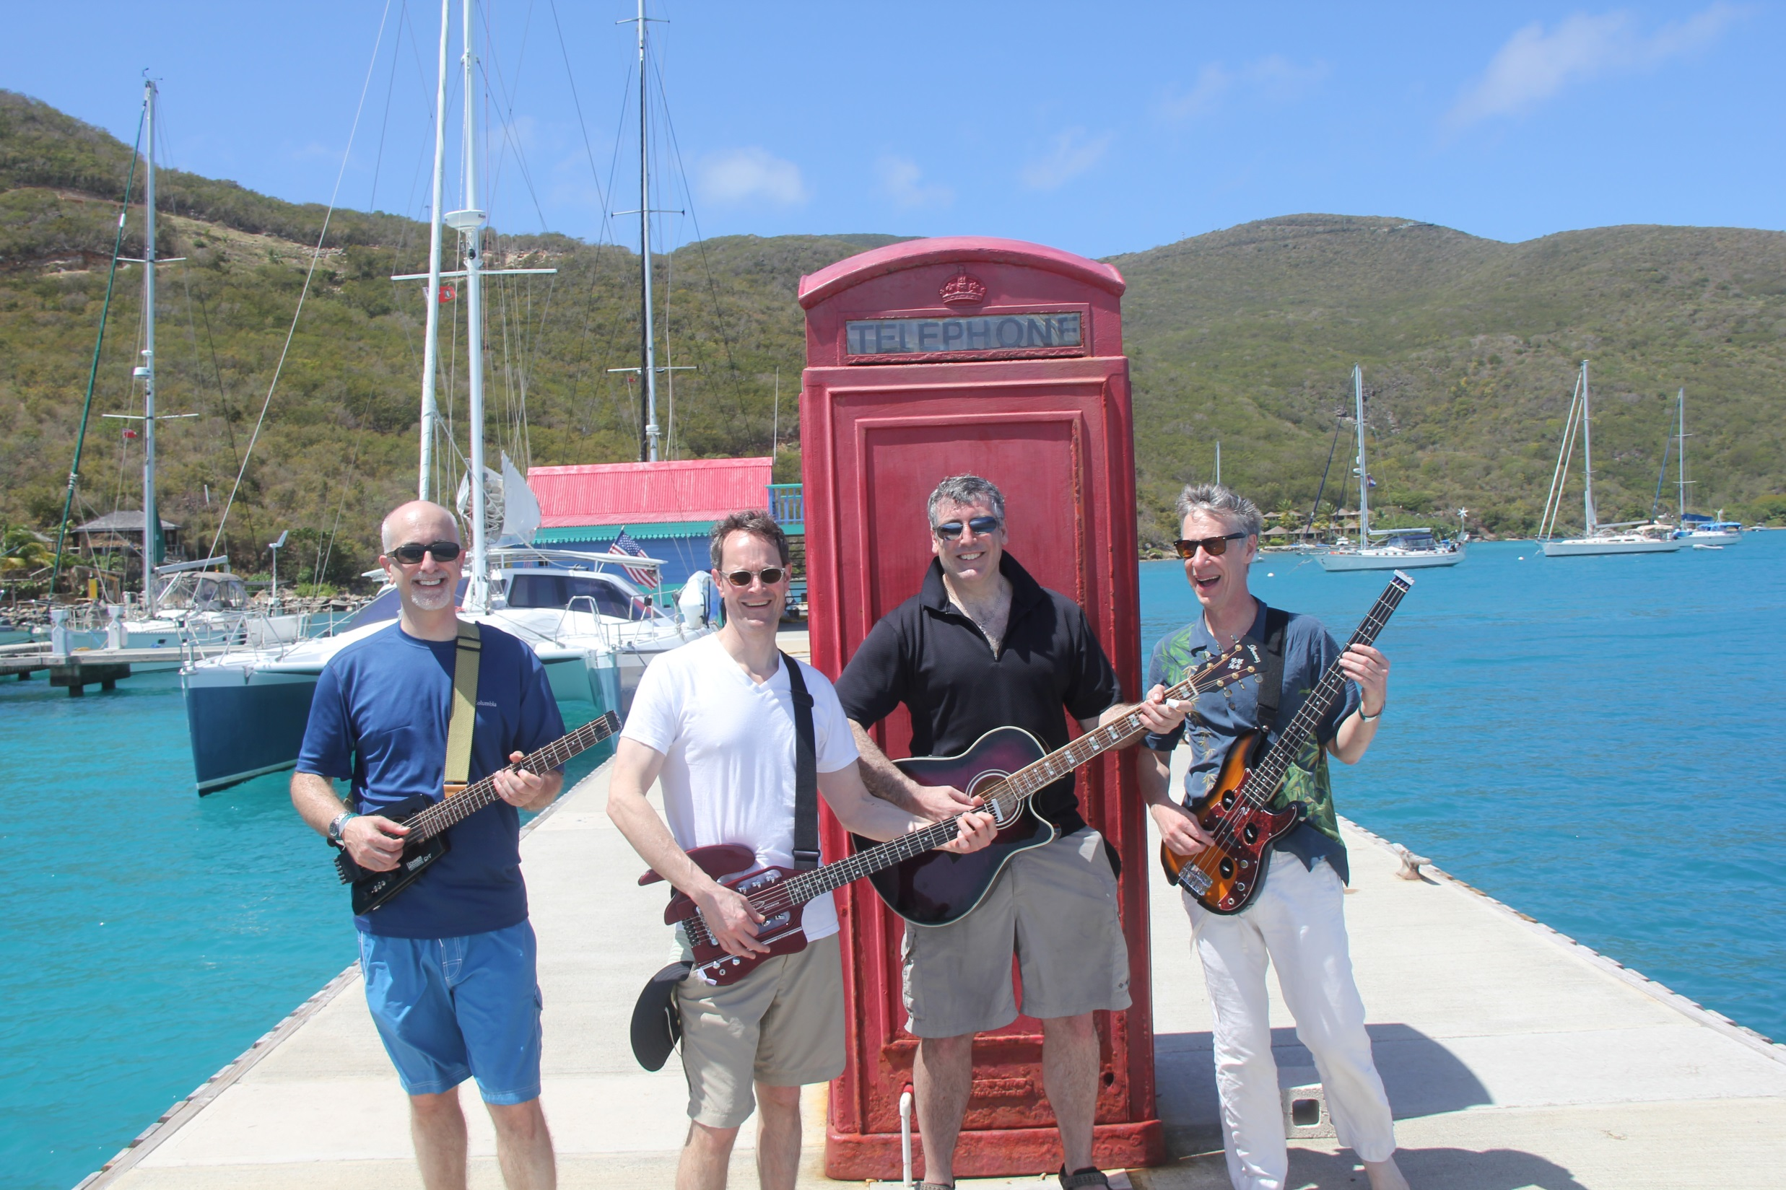

Slide 31
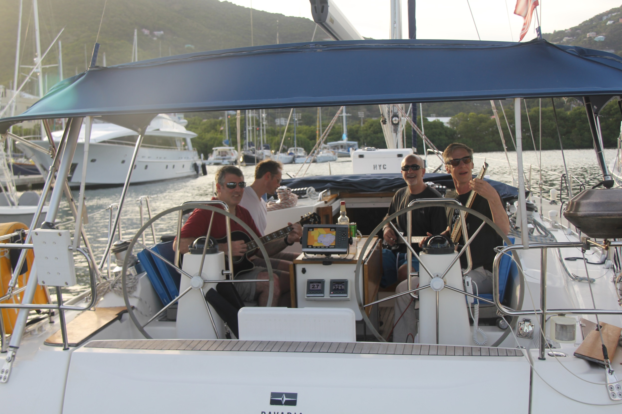

Slide 32
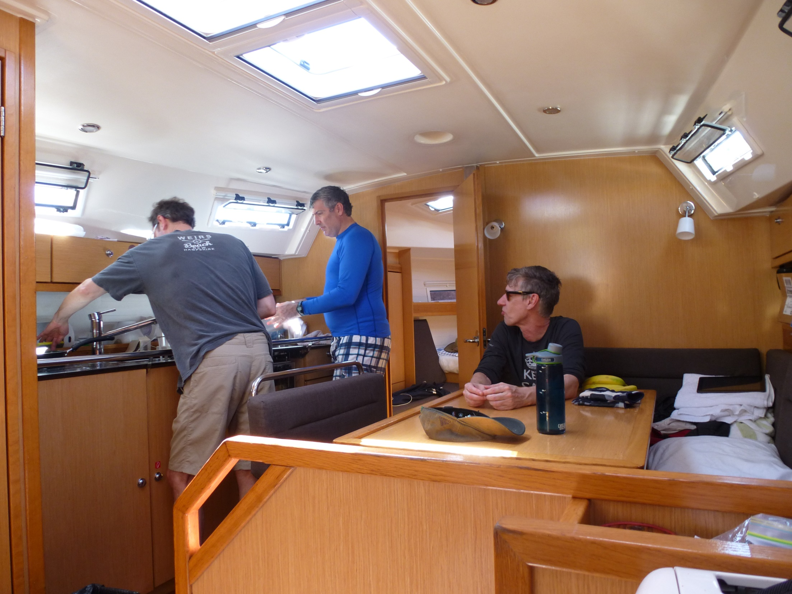

Slide 33
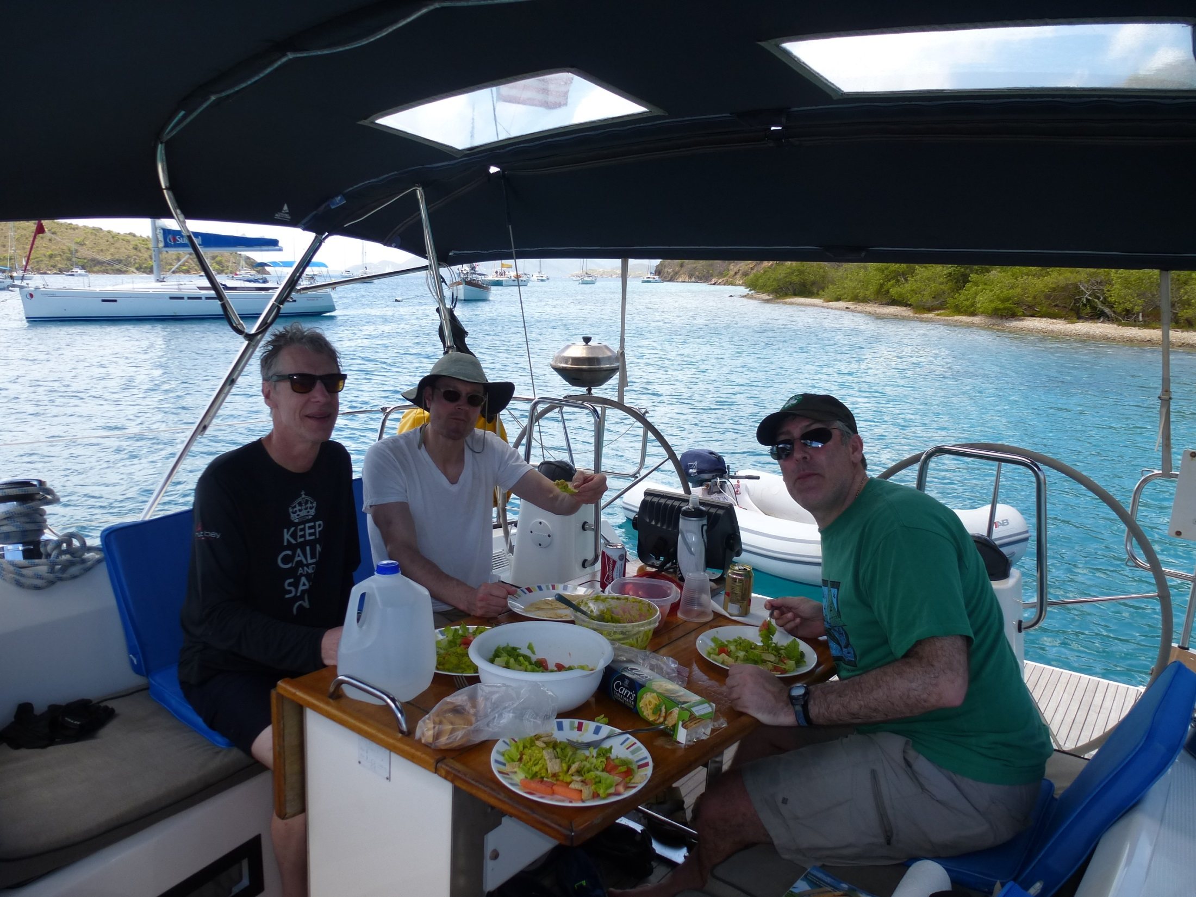

Slide 34
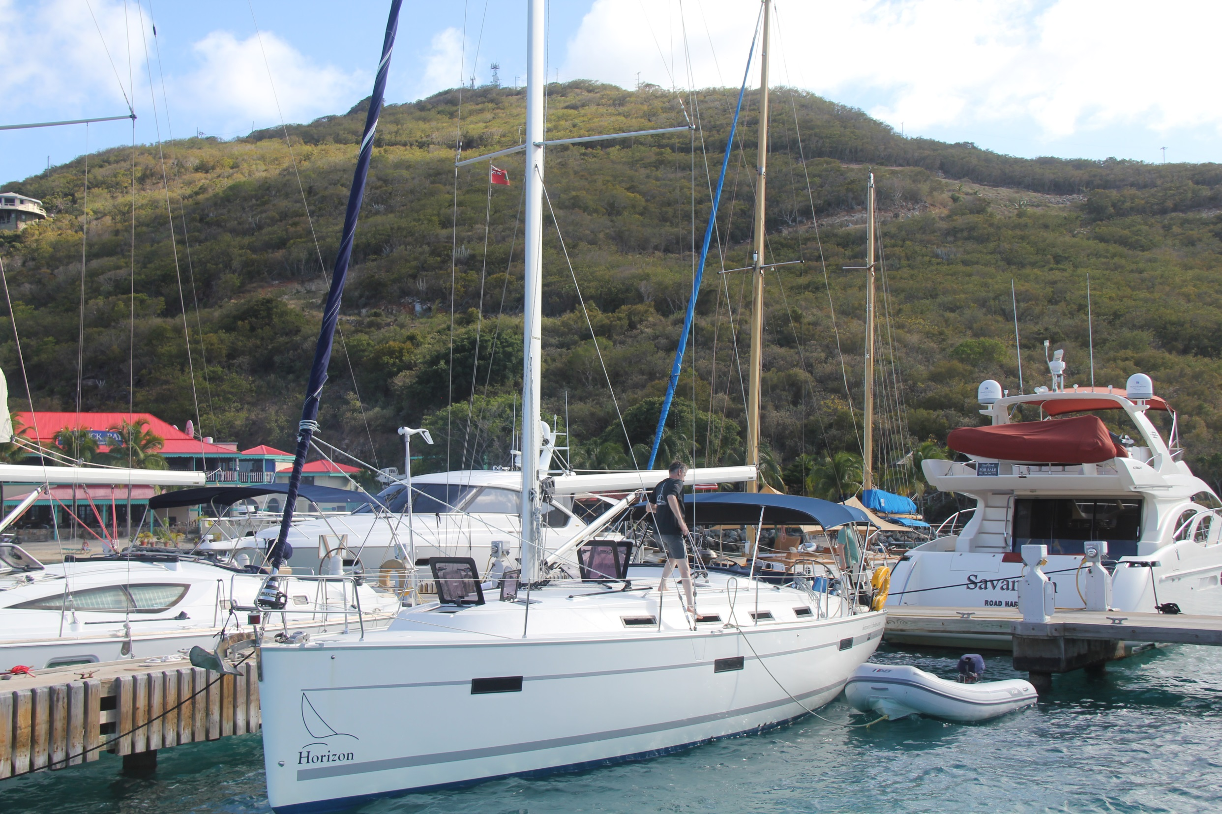

Slide 35
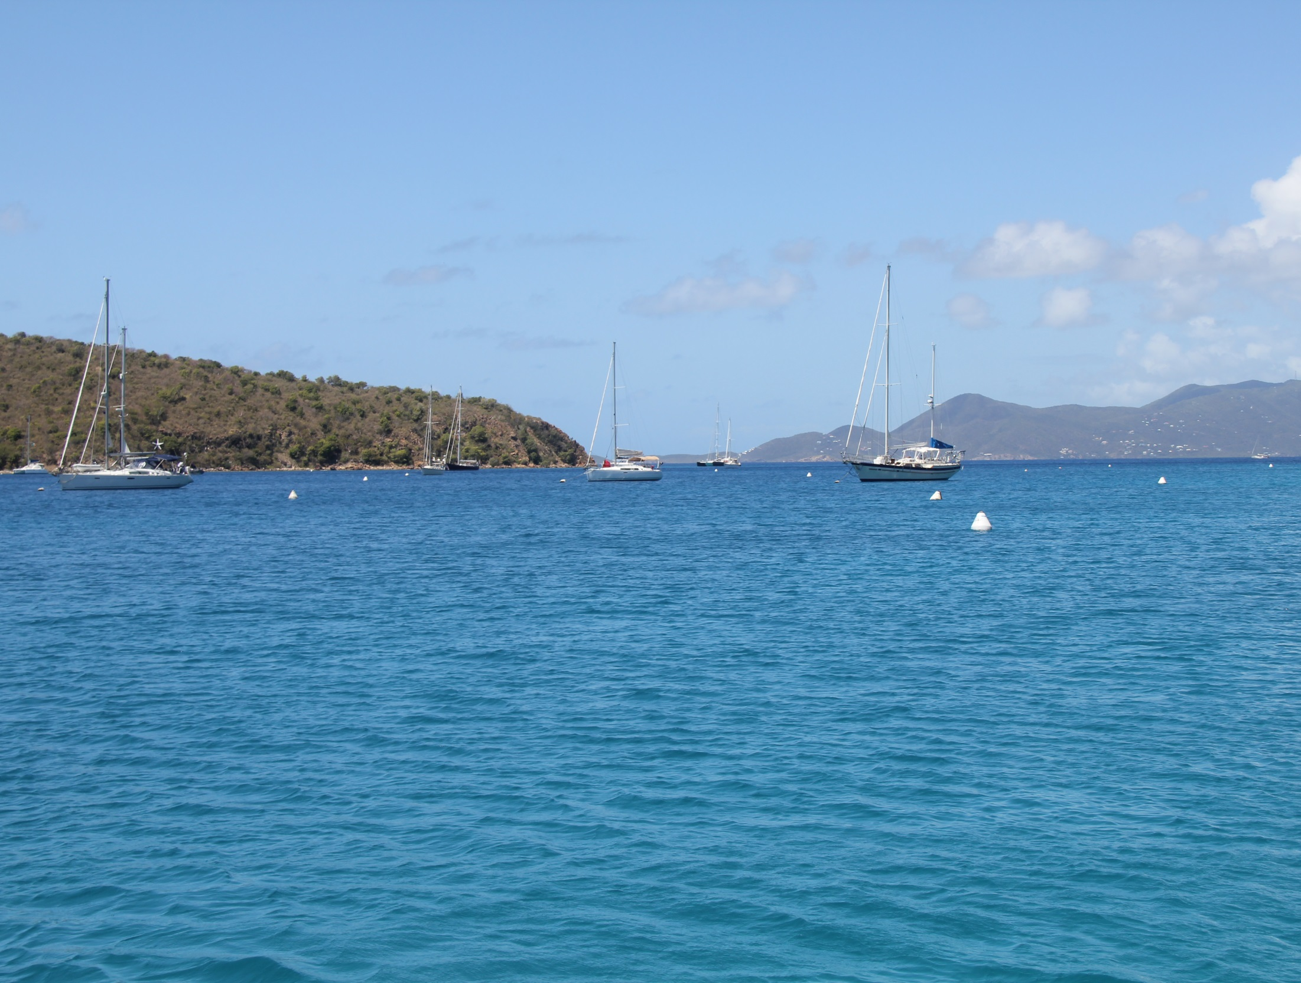

Slide 36
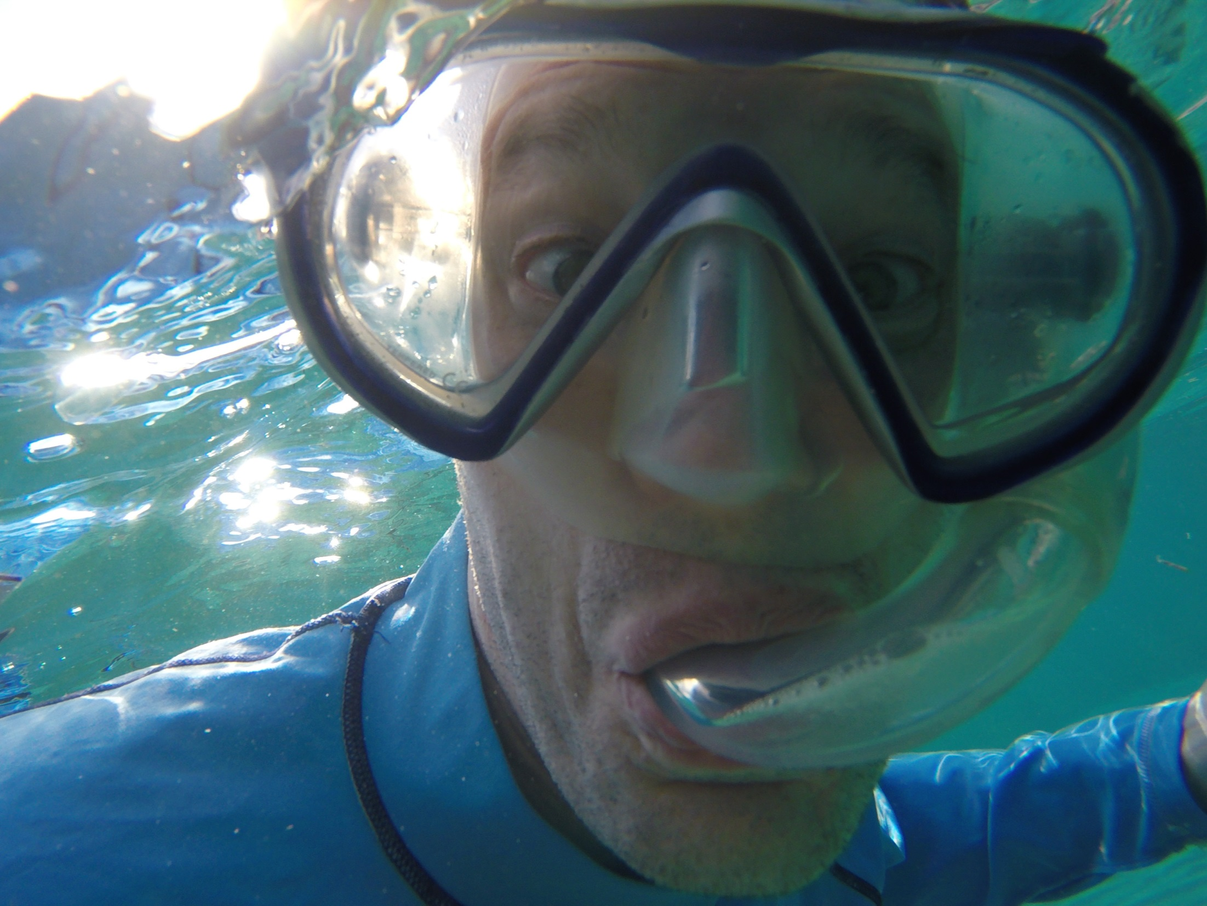

Slide 37
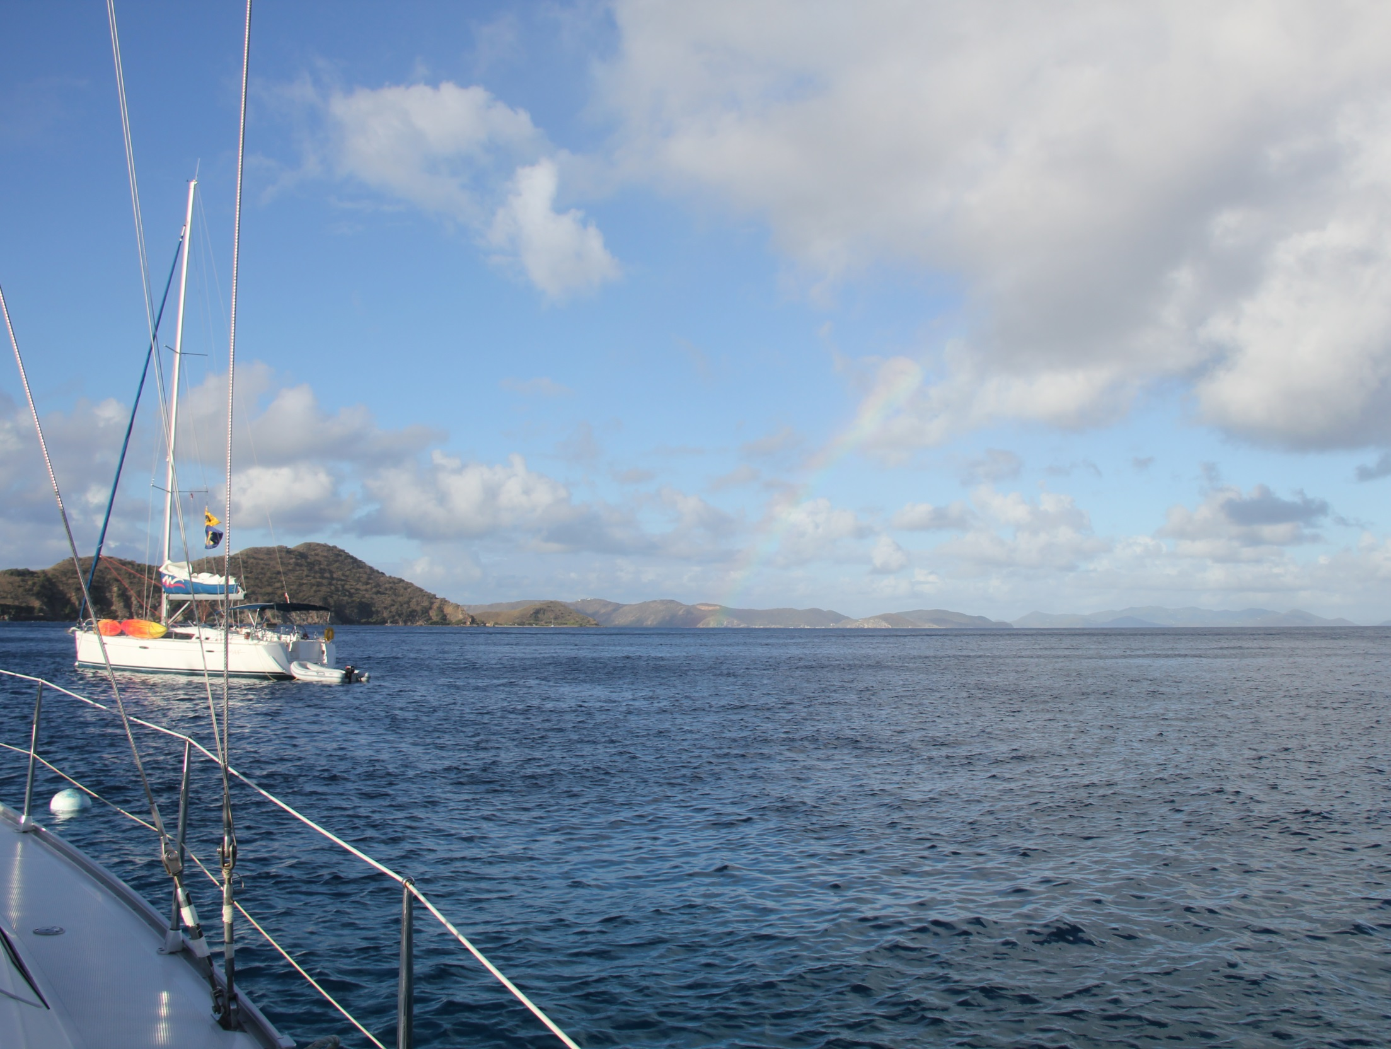

Slide 38
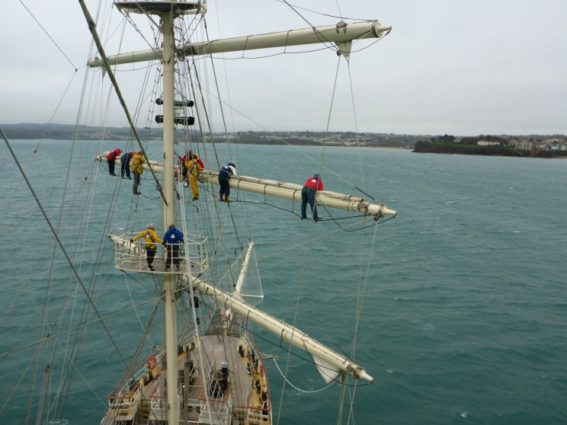

Slide 39
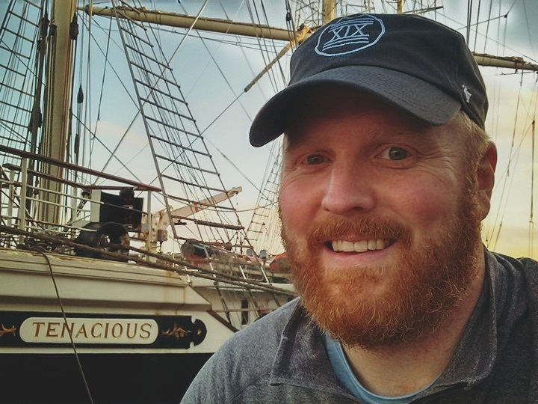

Slide 40
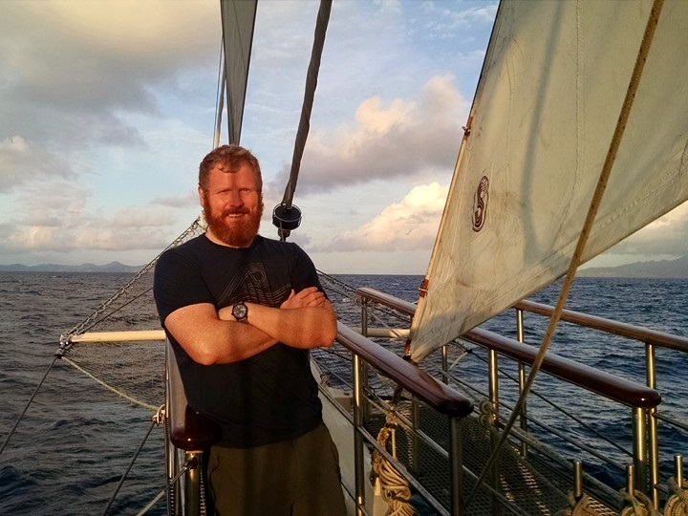

Slide 41
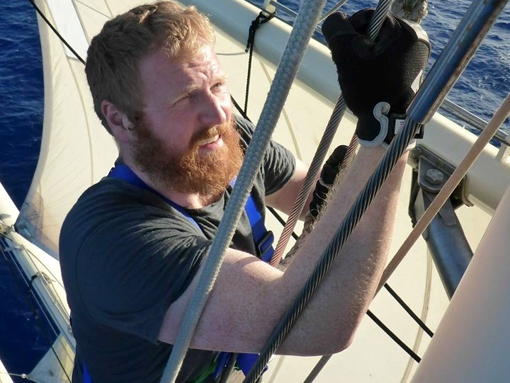

Slide 42
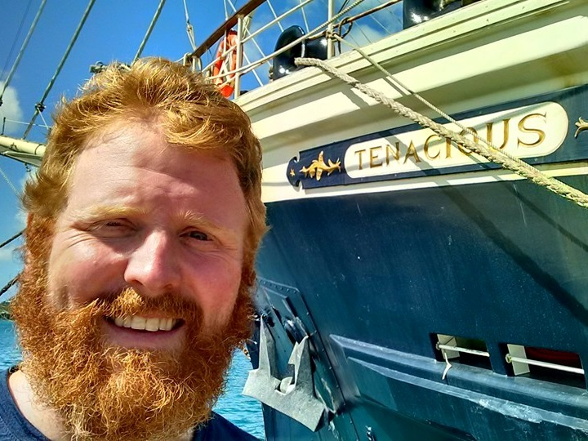

Slide 43
Chart Your Course
Sail with xDimension in 2016
Sign up for the Bluewater mailing list
Take a certified ASA keelboat training class
Charter a skippered sailing trip
Volunteer to crew on someone else’s boat
Sail across the Atlantic!

Slide 44
Let’s Look At Boats
Monohull vs. Catamaran
Cruiser vs. Racer
Short, Medium, or Long

Slide 45
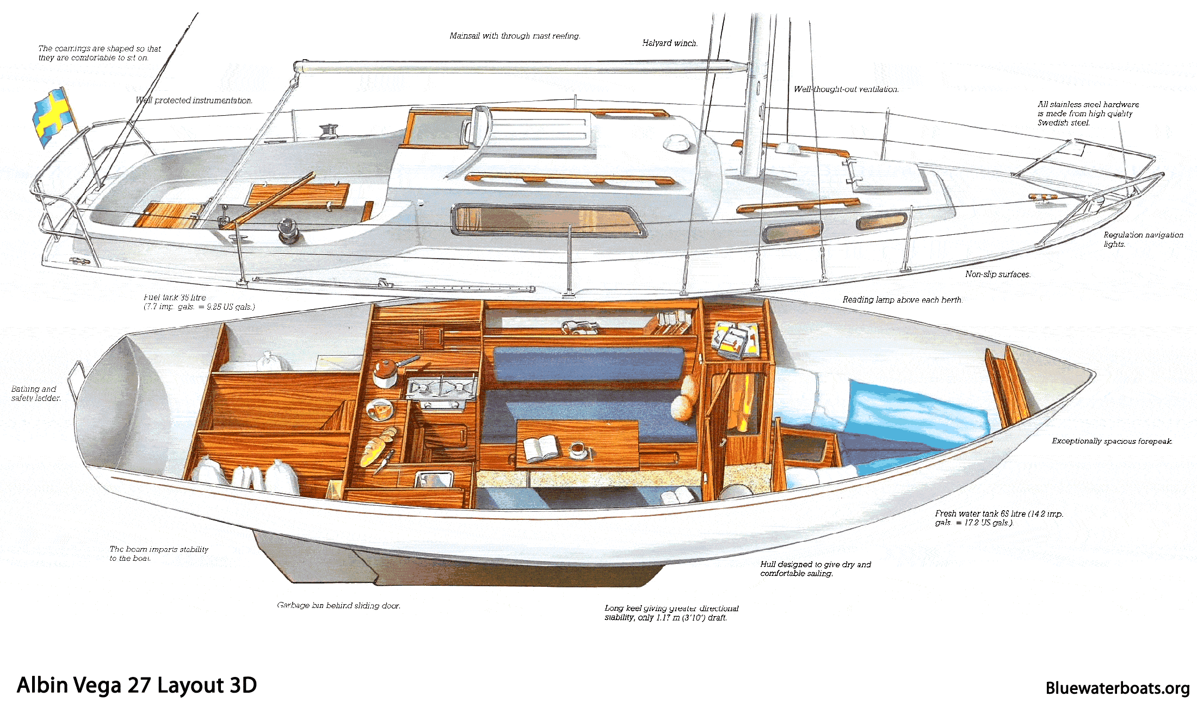
27’ Monohull

Slide 46
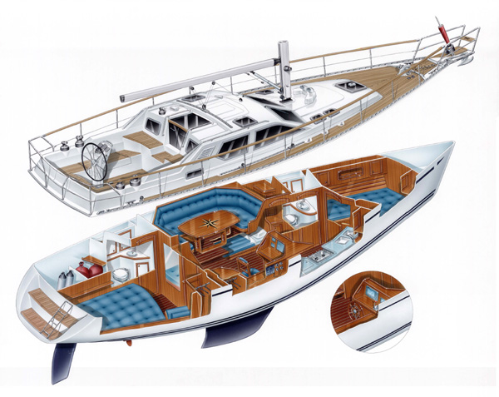
37’ Monohull

Slide 47
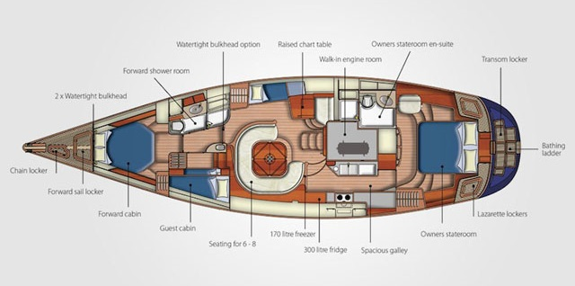
55’ Monohull

Slide 48
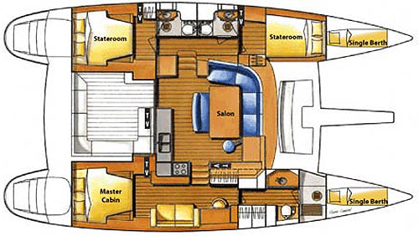
Catamaran

Slide 49
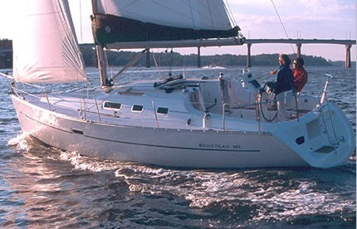
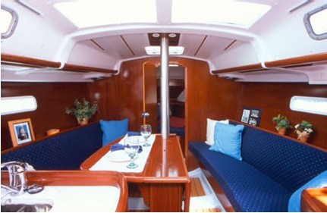
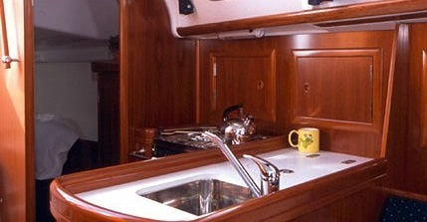
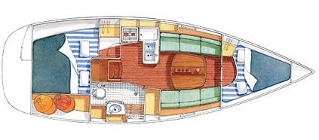
Oceanis 31

Slide 50
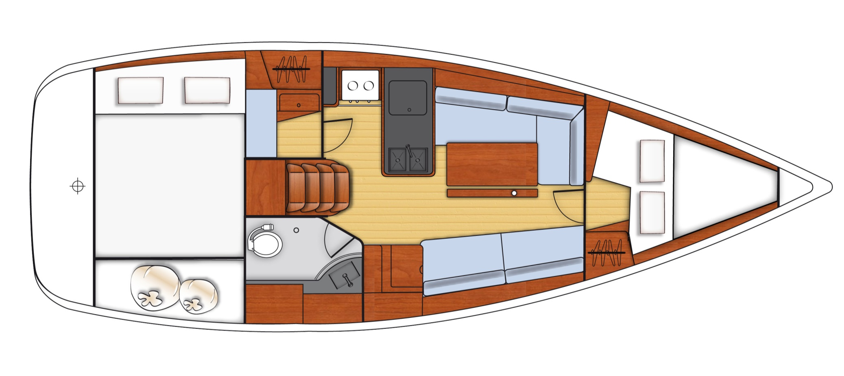
Oceanis 31

Slide 51
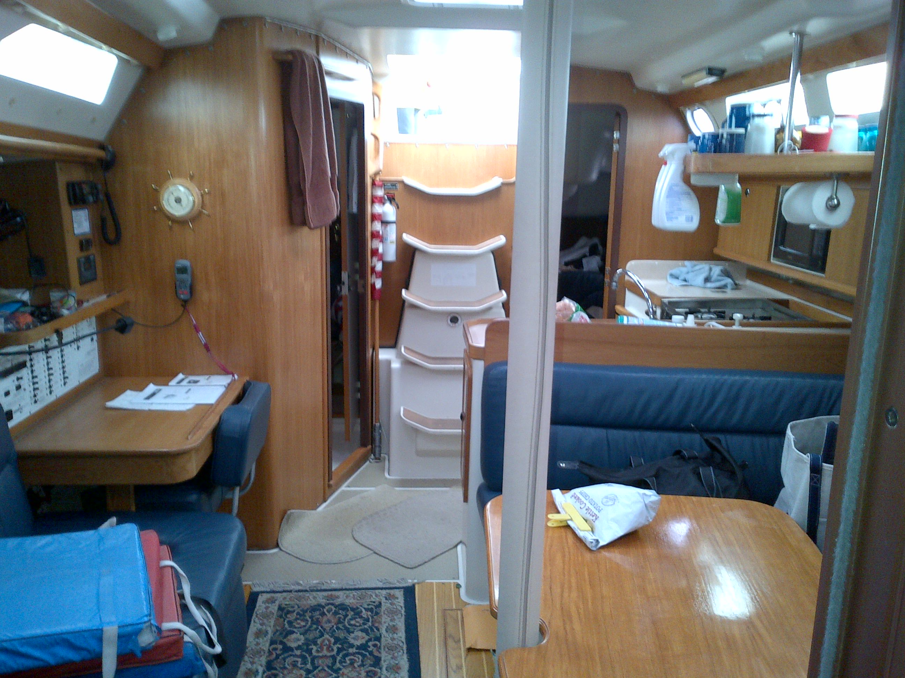

Slide 52
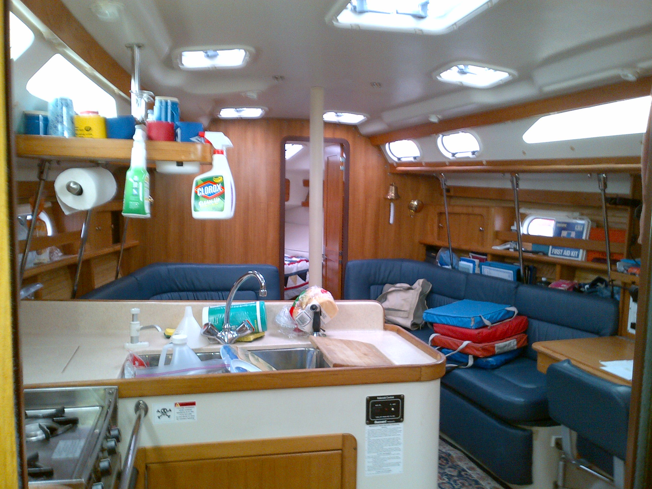

Slide 53
Boat Systems
Engine
Electrical
Navigation lights
Navigation Instruments
Communications
Rigging
Galley
Fresh water
Head
Bilge

Slide 54
Rigging

Slide 55
Galley / Fresh Water

Slide 56
The Head

Slide 57
The Head

Slide 58
The Head

Slide 59
The Bilge

Slide 60
The Bilge

Slide 61
Engine
Outboard
Inboard

Slide 62
Engine

Slide 63
Electrical

Slide 64
Electrical

Slide 65
Navigation Lights

Slide 66
Navigation Instruments

Slide 67
Navigation Instruments

Slide 68
Communications
Channel 16: International Distress, Safety and Calling.

Slide 69
Life Aboard

Slide 70
What To Bring?
Clothing (layers!)
Other
It might get cold
Hat, gloves, base layers
It might get hot
Sun cover, sun glasses, swim gear
It might rain
Jacket, overalls, boots
Toiletries
Sunscreen, lip balm
Medication, aspirin, etc.
Camera
Phone and car charger
Down time entertainment
Books and games

Slide 71
Sea Sickness

Slide 72
Do Your Job
Skipper (not you)
Helm
Jib Sheet(s)
Main Sheet / Traveler
Navigation
Galley Cook
Standing Watch

Slide 73
Two Knots To Know
Bowline
Cleat Hitch

Slide 74
Basic Safety
Walking around the boat
Skipper’s safety instruction
PFD (aka life vest)
Clipping into a jackline
Crew overboard procedure
Shout, Point, Throw
Calling for help
Ch 16: Mayday, mayday, mayday
Flares, horn, smoke, yell

Slide 75
What Next?
Keep coming to this IAP series
Join the Bluewater mailing list
Consider joining us in Maine this summer
Find a friend with a boat.

Slide 76
Fin

